Slide 1
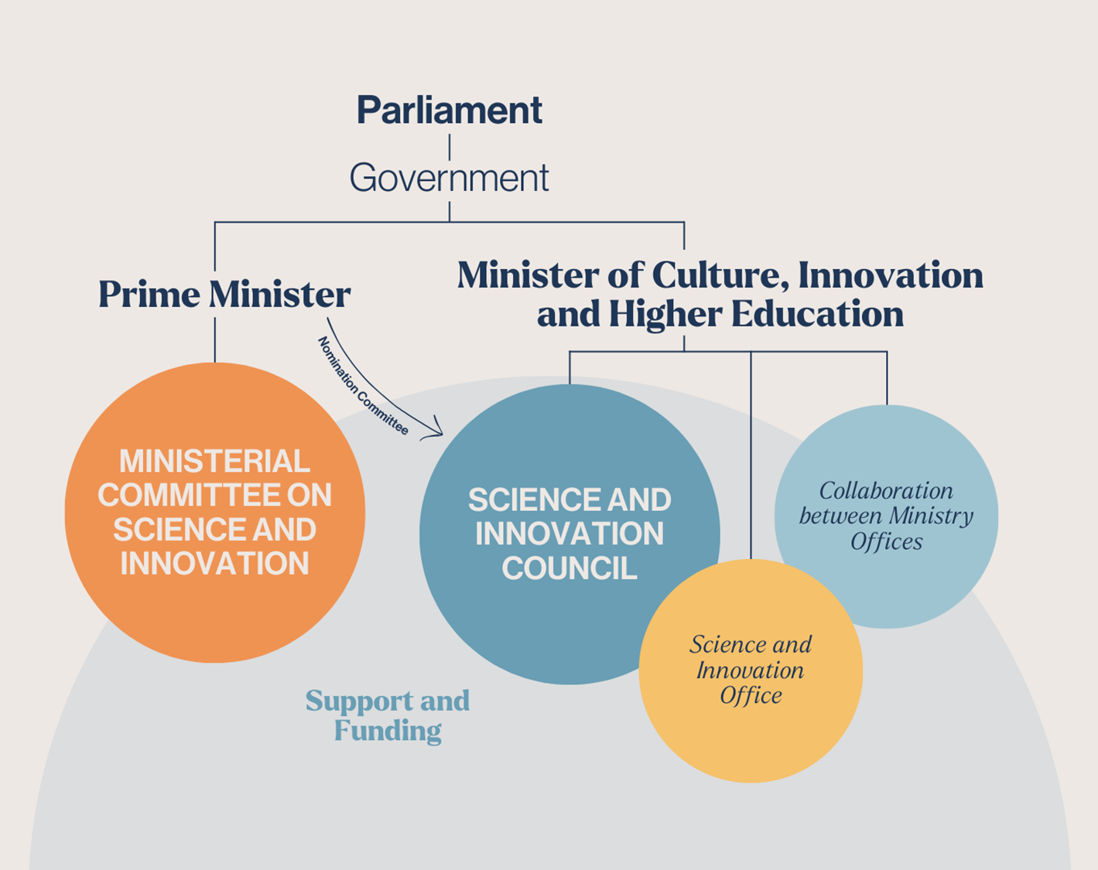
Future vision reflected in:
Policy on Science, Technological Development, and Innovation until 2035: The Government‘s Ten-Year Vision , with emphasis on attracting and maintaining new researchers and academic work force for Iceland
Freysteinn Sigmundsson
(chair of the Science and Innovation Council)

Slide 2

https://www.government.is/topics/science-research-and-innovation/science-and-innovation-council/
(or search for Science and Innovation Council)
Science and innovation are driving forces that underpin prosperity, social well-being and economic competitiveness, and value creation. Science, innovation, and technological advancement are keys to successful protection of the environment.
….. Iceland is a desirable location for top talent and internationally competitive research institutions and companies, and a place where they can carry out basic and applied research as well as innovation.
Its educational system is strong and encourages students to engage in creative and critical thinking from a young age.
…. By 2035, the aim is for research and innovation to make up 3.5% of the gross domestic product.

Slide 3
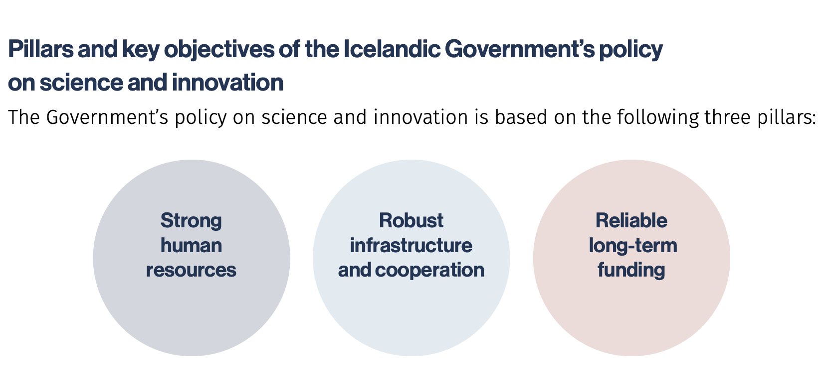
Future vision reflected in:
Policy on Science, Technological Development, and Innovation until 2035: The Government‘s Ten-Year Vision
https://www.government.is/topics/science-research-and-innovation/science-and-innovation-council/
(or search for Science and Innovation Council)

Slide 4
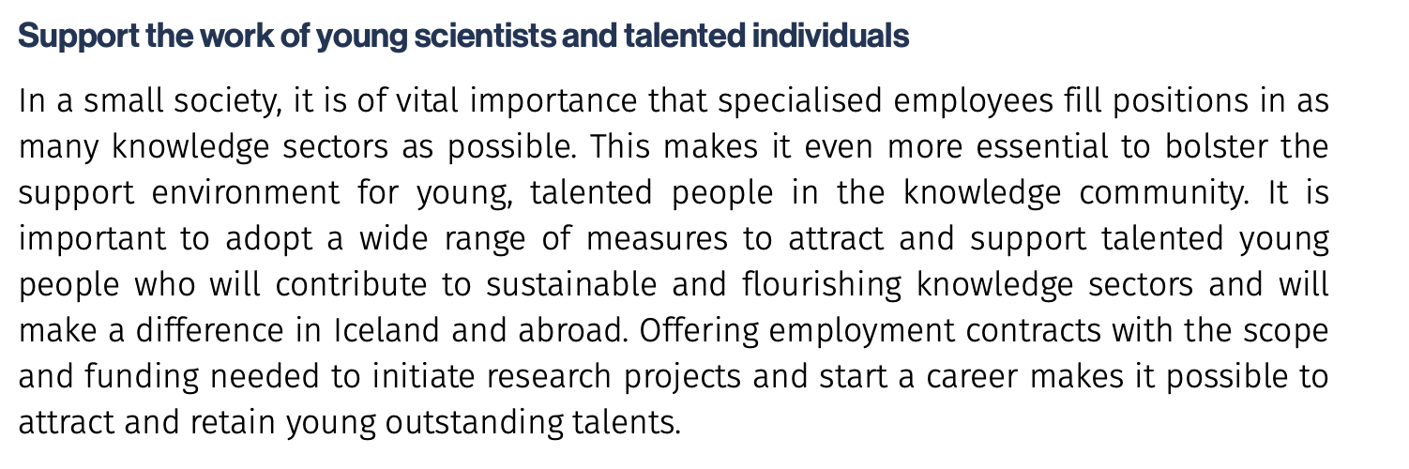

One of five objectives relating to strong human resources

Slide 5
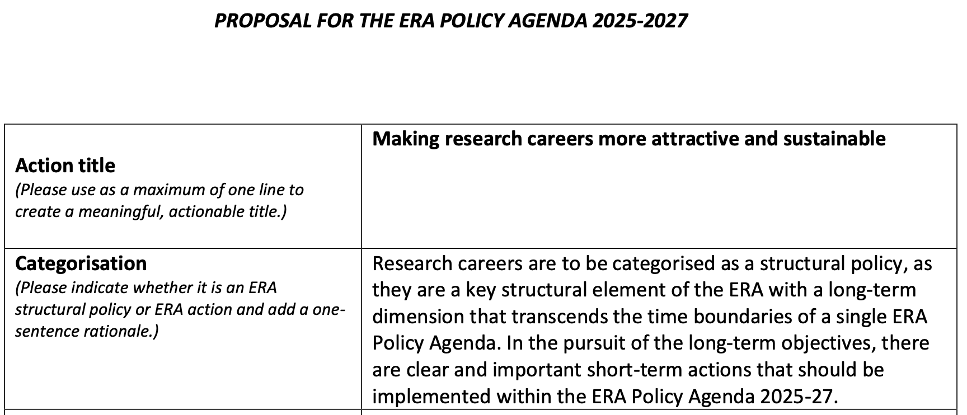
Iceland participates in action on implementing policy for making research careers more attractive and sustainable
... Still to be defined what that implies

