Slide 1
Wellbeing of PhD students and postdocs at the University of Iceland 2025
Dr Anamarija Veic
Co-Chair of FEDON
Postdoctoral researcher
School of Health Sciences, Speech Pathology
17th Sept 2025

Slide 2
Introduction
FEDON is the association of PhD students and Postdocs at the University of Iceland.
A total of 183 early-career researchers participated in our 2025 well-being survey, including 153 PhD students and 30 postdoctoral researchers. Among the respondents, 65% identified as women, 31% as men, and 5% as either non-binary or preferred not to disclose their gender. In terms of nationality, 55% were Icelandic, 23% came from countries outside the EEA, and 22% were from other EEA countries.

Slide 3
Wellbeing and mental health

Slide 4
An overview of average wellbeing (On a scale from 1 (very poor) to 10 (excellent), how would you rate your overall well-being over the past few months?) and the influence of PhD/postdoctoral work on wellbeing split by affiliation and citizenship.
 | Wellbeing in the past few months | To what extent do you feel your PhD/postdoc work negatively affects your well-being?
Affiliation | Mean | Extremely/significantly | Moderately/slightly | Not at all
Interdisciplinary program | 6.75 | 25% | 50% | 25%
School of Social Sciences | 6.59 | 13.6% | 72.7% | 13.6%
SENS | 5.98 | 30.4% | 56.5% | 13.0%
School of Education | 5.95 | 40% | 60% | NA
School of Health Sciences | 5.90 | 27.6% | 55.2% | 17.2%
School of Humanities | 4.94 | 34.3% | 62.5% | 3.1%
Postdocs | 5.83 | 36.7% | 53.3% | 10%
Citizenship (all respondents)
Country outside EEA | 5.61 | 26.1% | 66.6% | 7.1%
Iceland | 6.05 | 32.6% | 59.6% | 7.7%
Other country within EU/EEA | 5.55 | 29.5% | 50% | 20.5%

Slide 5
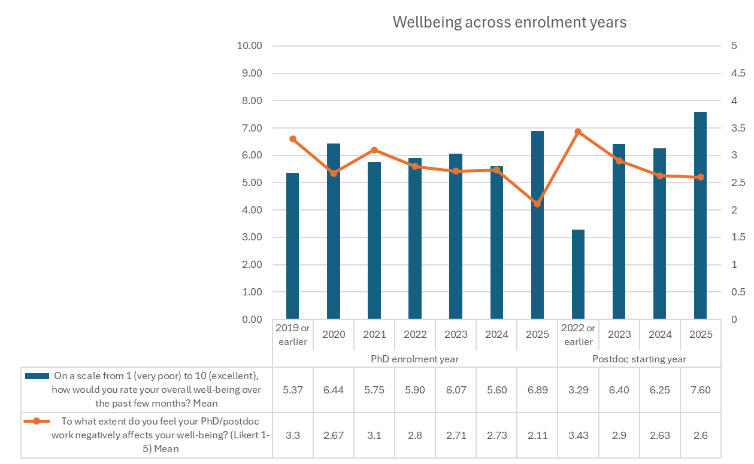

Slide 6
An overview of the primary reasons background factors negatively impact the wellbeing of PhD students and postdoctoral researchers. Respondents could select all that applied.
Pre-defined factor | Number of respondents | % of respondents
Workload/study pressure | 102 | 56.3%
Mental health challenges | 87 | 48.1%
Financial difficulties | 85 | 46.5%
Social isolation | 41 | 22.4%
Short-term physical health issues | 41 | 22.4%
Poor supervision or academic support | 39 | 21.3%
Long-term physical health conditions | 28 | 15.3%
None of the above | 16 | 8.7%
Other | 23 | 12.6%

Slide 7
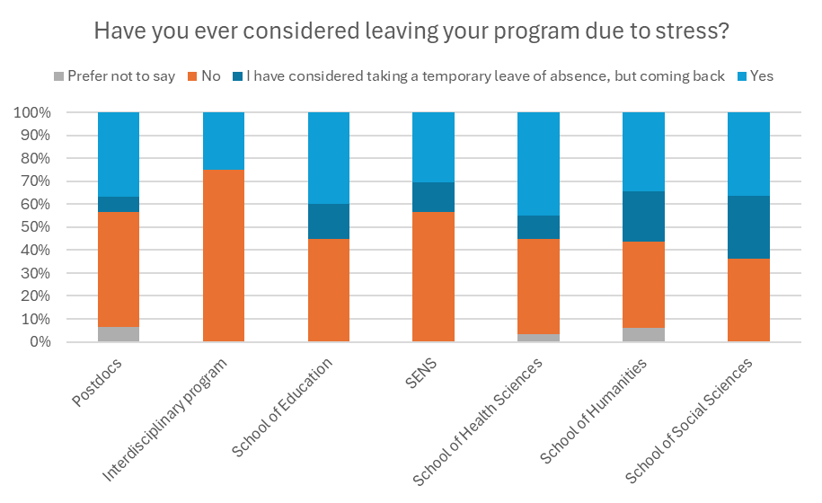

Slide 8
Supervision

Slide 9
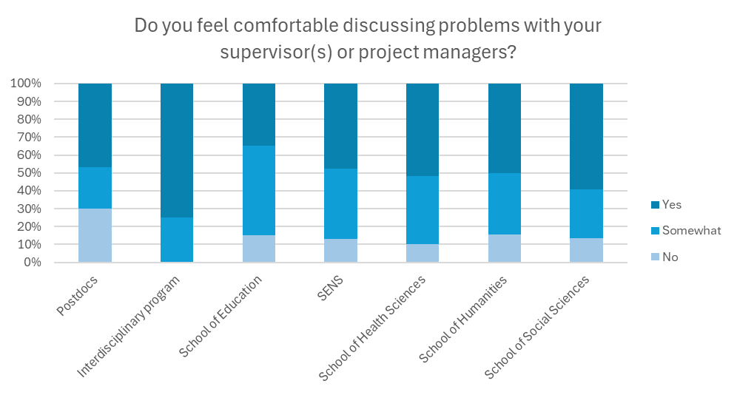

Slide 10
Respondents’ suggestions for improvements

Slide 11
Open-ended questions (N=48)
Theme 1: Funding
“There is a desperate need for funding and grants. The emphasis on finishing the PhD studies in good time, while there is a severe lack of available grants, significantly counteracts the quality and success of PhD students.”
Theme 2: Issues with supervisors and program structure
“(Re)organise phd programme, have supervisors go through training and be held accountable for their part. PhD students are still students and are here to learn. But we need to learn from someone.”
Theme 3: Community and mental health support
One comment specifically mentions having “next to no working relationship” with any members of their department after 5 years. The “need to create a community, a structure, and a support system for PhD students” is also mentioned.
Other issues raised
“Establish an office dedicated to disability issues that helps individuals with disabilities navigate the university and supports them throughout their PhD and postdoctoral journeys.”

