Slide 1
Using Data and AI to proactively support academic staff and students and facilitate quality assurance for learning and teaching
María Stefánsdóttir Berndsen
Project Manager - Development of Distance Learning and Learning Management Systems
mariab@bifrost.is

Slide 2
Private and personal – a point of pride
Private University
Tuition fees until 2024
Limited number of students – small groups in most courses
Fully online
Different demographic from other Icelandic Universities
Most students work part-time or full-time
Emphasis on high-quality education and personalized services for students
Annual student surveys show that a vast majority is highly satisfied with their studies and the services provided by both academic and support staff

Slide 3
Student satisfaction

Slide 4
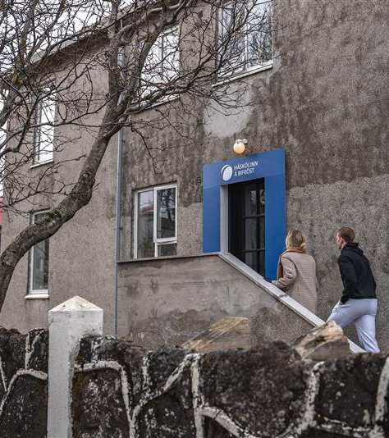
Big changes
Since the 2024-2025 Bifröst University has not charged admission fees
Students now pay an annual registration fee
What did this entail?

Slide 5
Exponential growth!

Slide 6
Number of students
Notes:
Undergraduate Graduate Total
Faculty of Social Sciences 314 166 480
Faculty of Law 131 78 209
Faculty of Business 397 720 1117

Slide 7
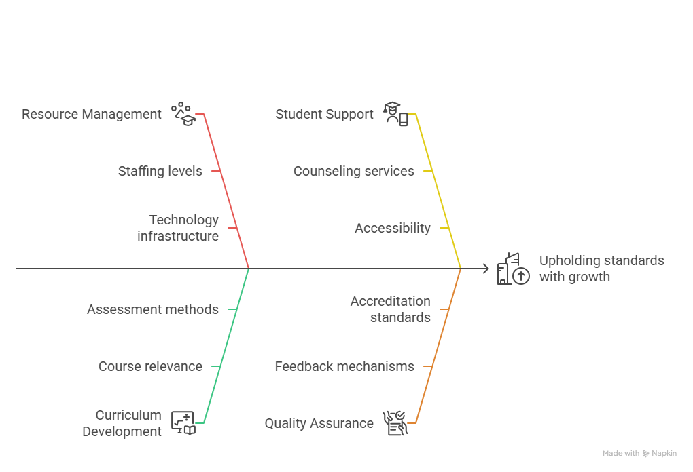
The challenge: How do we maintain our standards and continually improve?
Hire more staff – both academic and support - 24% increase between December 2023 and December 2024
Invest in infrastructure

Slide 8
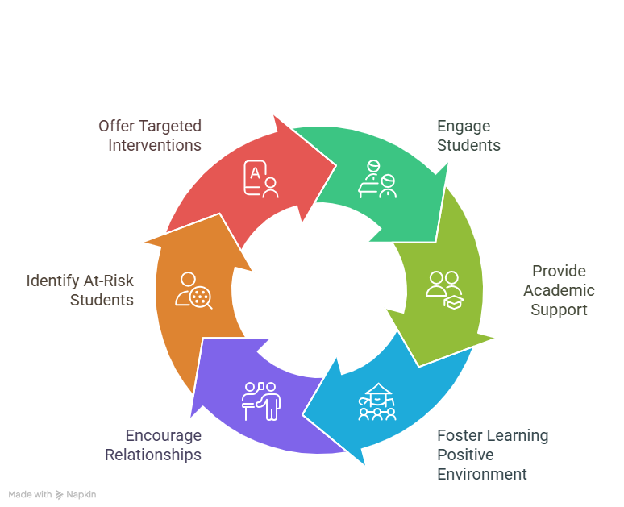
Student retention
Bifröst has for a long time placed high emphasis on supporting students on their study journey
Academic staff provide a high-level service
Study counselors play a key role in identifying students at risk and providing those students with custom support
Early intervention is key

Slide 9

What are we doing and how can we keep doing it?
All applicants receive a personal phone call from either a member of staff or a specially trained member of the student body
Our semesters are divided into two terms each
Nine days after each term commences, the study counselors review data from the LMS to identify students at risk
Then they call the students in question to offer support
If a student cannot be reached by phone, they are sent an email
Is this feasible with the increasing number of students?

Slide 10
Enter Intelligent Insights
Implementation commenced at the beginning of the first session of the spring semester 2025
We decided to implement the tool slowly due to limited resources
Initial focus on the Student Success tool and Ask Your Data – spring 2025
Began experimenting with the Course Effectiveness tool in spring 2025 – full implementation autumn 2025
Current users: Study counselors and Instructional advisors

Slide 11
Students At Risk: The workflow
“By combining data-driven tools with personal follow-up, we are not only reducing dropout risk but also building stronger relationships with our students.”
With an increased number of students and the abolition of tuition fees, we feared we would see higher dropout rates
Before we began the implementation process, our study councilors had to rely on people from IT to provide them with the necessary data
The data had to be collected from two different sources, which they then had to review manually
Time-consuming and resource-heavy process
Now they are self-sufficient and able to get access to the necessary data when needed, by themselves, and thus better equipped to identify and support at-risk students

Slide 12
Course Effectiveness: The workflow
“We’re only just scratching the surface, but already, Intelligent Insights has been a gae-changer. It’s helped us scale without sacrificing our values.”
Before implementation, numerous working hours were spent manually reviewing course pages within the LMS before each term commencing
Due to constrained resources, the scope of follow-up activities was limited
With Intelligent Insights, the data we require is just one click – or one prompt – away
The tool enables us to monitor faculty issues, such as missing or misconfigured assignments, delayed feedback, and grading inconsistencies
New possibilities – questions we had not even imagined we could find the answers to!

Slide 13
Why is this important?
Provides us with means to support our academic staff and while providing an even better learning experience to the students
Before, we could rarely detect problems until after a course was finished
Intelligent Insights provides us with the chance to intervene early, sometimes even before potential issues escalate
Allows us to track quality while courses are ongoing or even before they commence
Saves time and labor
Helps us capture “the small stuff” that we didn’t have the time or human resources to review before
Provides consistent, reliable, and actionable data that supports accreditation and continuous quality enhancement
As our confidence level in using Intelligent Insight grows, we will add more users and start experimenting with the other tools – but we are fully aware of our limitations

Slide 14

Coming up
Adding more users – the faculty secretaries are next in line
Prompt refinement
Getting academic staff more familiar with the extra Course Analytics feature that is available for all teachers within institutions that use Intelligent Insights
As we get more familiar with the tool and as it develops, we discover more ways to use it and come up new questions to ask, some of which we had never anticipated being asked and answered

Slide 15

Hiccups
It hasn’t just been a smooth journey, and we are not as far along at this point as we had planned
Being an implementation team of one is challenging
The Icelandic language
Prompt effectiveness

Slide 16

What have we learned?
Intelligent Insights is “just” a tool like other AI tools. It doesn’t do the work for you
If you make the effort to learn how to utilize it and understand its potential, we have found that Intelligent Insights will provide much-needed support, makes our work easier, and more efficient
Gives you the chance to explore things that you didn’t have the time, or the imagination, to investigate before
It is fun to play around with, but it also provides us with opportunities to enhance the student experience and to provide structure and support to our teachers, as well as a practical resource to fulfill our formal obligations regarding quality assurance and control

Slide 17
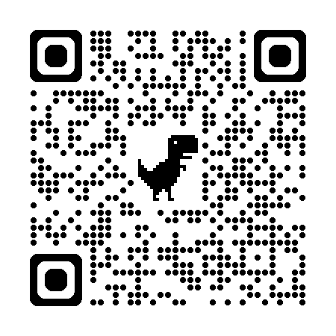
Thank you!
mariab@bifrost.is

