Slide 1
Beyond the classroom: From study to success in Scottish universities

Slide 2

Keynote themes
Context: The Scottish sector and landscape
  External environment: challenges and opportunities
  The changing diversity and needs of our student body
  Aspiration: Creating a world class student experience “beyond the classroom”
  Prevention, Proactivity, Partnership, Prioritisation
  Increasing efficiency without compromising on impact
  The rise of whole-university student life or student experience models

Slide 3
The challenge and the aspiration
Scottish universities are facing unprecedented challenges in their pursuit of the delivery of an exceptional, world class student experience. Student diversity and needs are more complex than ever before, and the fiscal, regulatory and socio-economic environment is challenging and uncertain.
Yet one common goal endures: to nurture skilled, employable, resilient and fulfilled global citizens who are ready and able to seize opportunities, overcome challenges and play their part in making the world a better place.

Slide 4
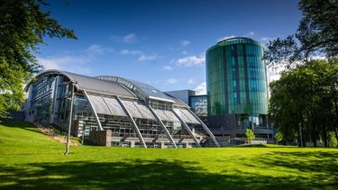


Scottish sector landscape
19 autonomous higher education institutions
Of these, 16 hold full “university status”; 3 other degree-awarding institutions.
Education policy (including higher education) is devolved, controlled by the Scottish Government.
Represented by Universities Scotland
Funding is allocated by Scottish Funding Council (SFC)
Outcome agreements and wider regulatory framework

Slide 5
Student recruitment trends
Metric 2023-24 | Value | As a % of total | Notes / Trend | Notes / Trend
Total student enrolments | 281,500 | / | Including Scottish domiciled, the rest of the UK (RUK), EU, and non-EU international students. | Including Scottish domiciled, the rest of the UK (RUK), EU, and non-EU international students.
Scottish domiciled students | 173,795 | 61.7%
International / non-UK student numbers | 64,170 | 22.8% | Down from 71,635 the year before (2022-23) — a drop of over 10%. Peak year 2021-22 (over 73k) | Down from 71,635 the year before (2022-23) — a drop of over 10%. Peak year 2021-22 (over 73k)
EU student numbers | 10,430 | 3.7% | Continuing decline since Brexit. 13470 in 2019-20 (29% decrease) | Continuing decline since Brexit. 13470 in 2019-20 (29% decrease)
Rest of UK (RUK) | 33,100 | 11.8% | Steady for past several years | Steady for past several years
Widening participation (% of first degree, full time entrants from the most 20% deprived areas) |  | 16.70% | Up slightly from 16.3% in previous year - 2023/24 was highest figure | Up slightly from 16.3% in previous year - 2023/24 was highest figure
Figures compiled from published summaries and tables from HESA and the Scottish Funding Council (SFC). Sources include:
- HESA: Higher Education Student Statistics releases (2020-21 to 2023-24).
- Scottish Funding Council: Higher Education Students & Qualifiers (annex and background tables) 2019-20 to 2023-24.
Notes:
The number of Scottish students (domiciled in Scotland) has risen slightly in 2023-24 compared to previous years. scottishgov-newsroom.prgloo.com+1
Meanwhile, international student numbers have fallen notably, especially non-EU students and particularly at postgraduate taught level:
Widening access is progressing: in 2023-24, 16.7% of full-time first degree entrants came from Scotland’s 20% most deprived areas. That’s slightly up from 16.3% the previous year.

Slide 6
University | Female | Male | Unknown | Total
The University of Aberdeen | 8,980 | 6,450 | 20 | 15,455
Abertay University | 2,360 | 2,565 | 25 | 4,950
The University of Dundee | 9,850 | 5,115 | 25 | 14,990
Edinburgh Napier University | 7,585 | 6,640 | 20 | 14,240
The University of Edinburgh | 25,290 | 15,105 | 230 | 40,625
Glasgow Caledonian University | 12,310 | 9,645 | 15 | 21,965
Glasgow School of Art | 1,795 | 765 | 80 | 2,640
The University of Glasgow | 22,775 | 14,915 | 435 | 38,125
Heriot-Watt University | 4,165 | 6,365 | 140 | 10,665
The Open University | 11,820 | 7,205 | 5 | 19,030
Queen Margaret University, Edinburgh | 5,315 | 1,500 | 20 | 6,835
Robert Gordon University | 8,765 | 5,775 | 50 | 14,585
Royal Conservatoire of Scotland | 720 | 475 | 20 | 1,220
The University of St. Andrews | 7,100 | 4,745 | 45 | 11,895
SRUC | 1,140 | 625 | 30 | 1,795
The University of Stirling | 7,690 | 5,145 | 30 | 12,865
The University of Strathclyde | 12,075 | 11,070 | 120 | 23,265
University of the Highlands and Islands | 5,915 | 3,525 | 95 | 9,530
The University of the West of Scotland | 10,195 | 6,390 | 190 | 16,780
Total | 165,830 | 114,020 | 1,605 | 281,455
Notes:
Note there are significant variances between universities, with a small number of universities more successful in RUK and international student recruitment and some being much more local in terms of their recruitment to date. Significant differences in success around meeting widening access targets, due to factors such as urban/rural splits.

Slide 7
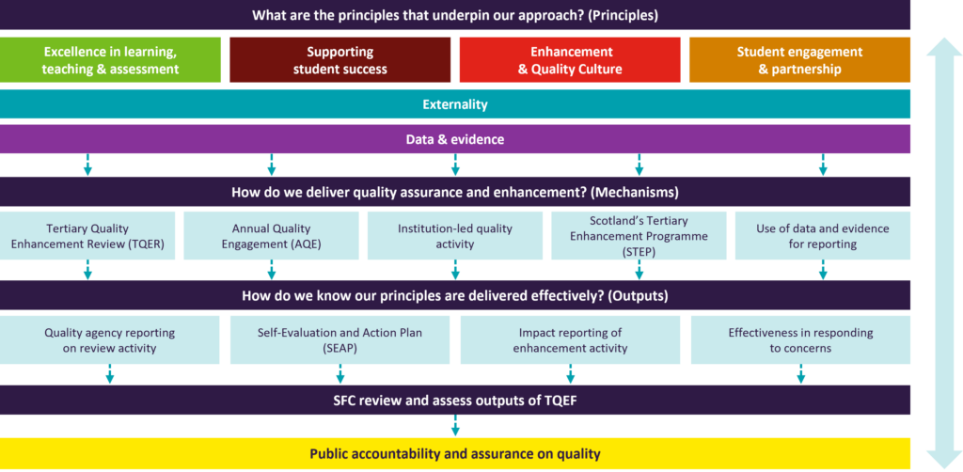
Tertiary Quality Enhancement Framework (TQEF)
Notes:
Scotland’s Tertiary Quality Enhancement Framework - Scottish Funding Council
Is the provision delivered by Scotland’s colleges and universities of high quality and is it improving?
SFC partnered with our colleges, universities, sector leading bodies, agencies and students to create the TQEF and it was fully implemented from the 2024-25 academic year. The TQEF will:
Protect academic standards and enhance the student learning experience.
Ensure our quality arrangements continue to be fit for purpose to support innovation in learning and more flexible models of delivery.
Help create seamless pathways for learners and support more students to achieve positive outcomes.
Support more effective collaboration across colleges and universities, removing barriers to the sharing of innovation and learning, thereby promoting tertiary collaborations, where institutions wish to do so.
Foster a shared learning community leading to a common language and culture around learning and teaching across the tertiary system.

Slide 8
A broken funding model
Scottish government provides grants for teaching, allocated by the Scottish Funding Council (SFC).
“Free education” Tuition fees for Scot-dom students paid by SAAS. Unis cannot charge fees.
English system no grants; model based on charging of fees but they have not kept up with inflation
Westminster Government has allowed for a small % increase this year and in future years
Unsustainable funding model
Notes:
The funding received for teaching Scottish students does not cover the full teaching costs, forcing universities to rely heavily on international student fees to subsidize these costs.
This reliance creates financial instability, as university income levels can fluctuate depending on international recruitment.

Slide 9
Research grants – also very competitive
Aggressive international recruitment
Overseas delivery/TNE/ collaborations
Unstable model, fluctuating income
Commercial strategies and growth plans
Fundraising/ alumni/ philanthropy
Notes:
The funding received for teaching Scottish students does not cover the full teaching costs, forcing universities to rely heavily on international student fees to subsidize these costs.
This reliance creates financial instability, as university income levels can fluctuate depending on international recruitment.
Universities also generate income from international student fees, research grants, and other sources to supplement government funding, which is often insufficient for teaching costs. This dual system has created financial pressure on universities, leading to a reliance on foreign student fees to subsidize domestic teaching costs.

Slide 10
Immigration and international student recruitment
UKVI restrictions are hindering student recruitment
  Increased barriers to entry (restrictions on dependents; reduction of graduate route from 24-18 months; tighter restrictions around accessing graduate route and minimum salary thresholds)
  Stringent attendance requirements
  New strict caps on proportion of online delivery
  Potential new levy on international student fee income

Slide 11
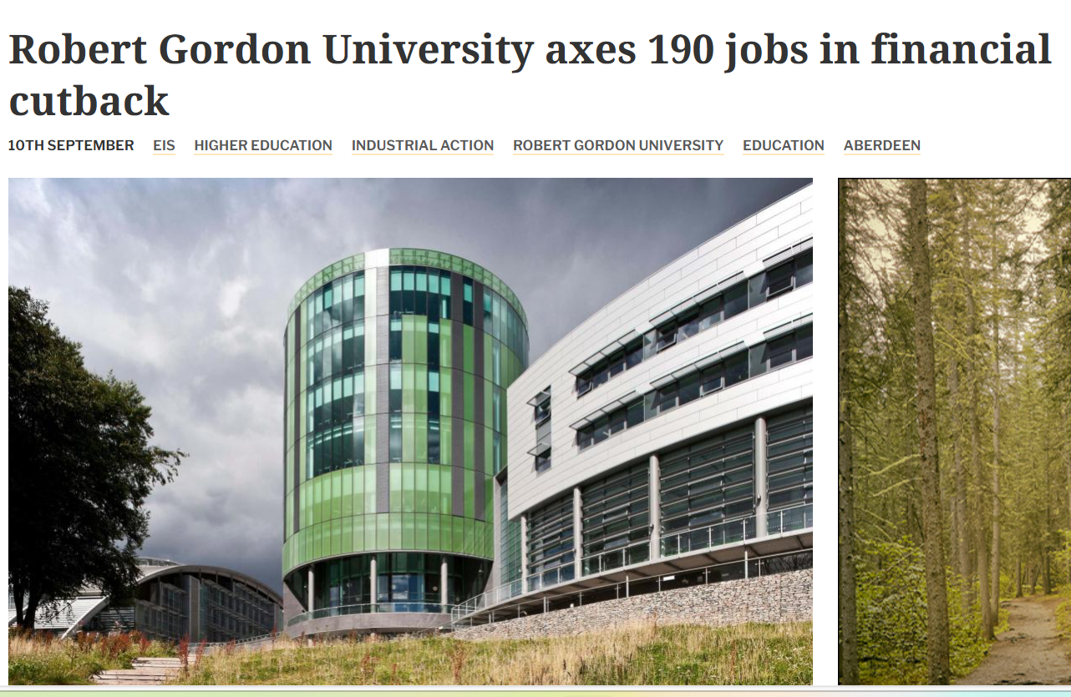
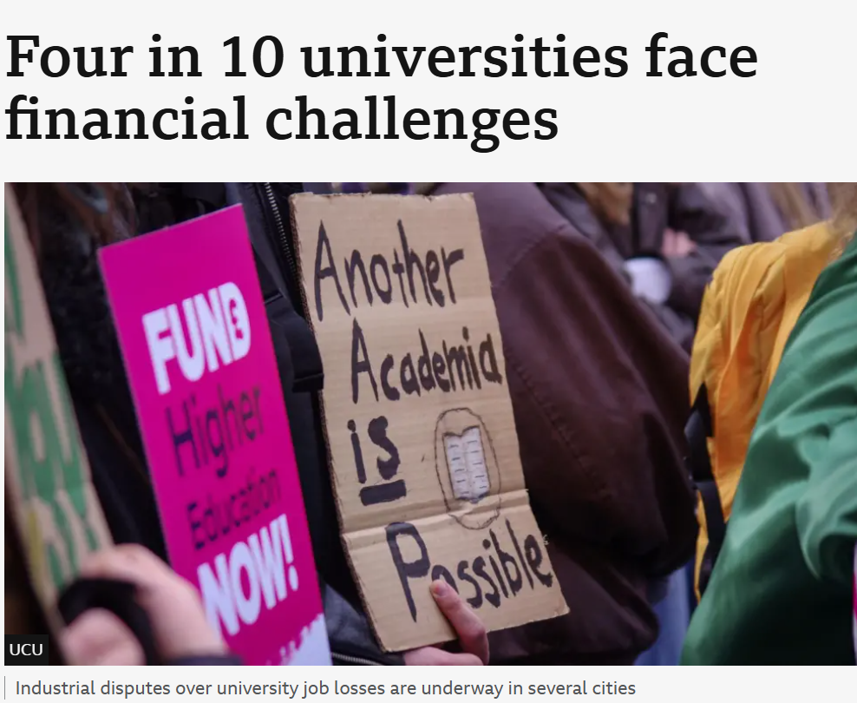

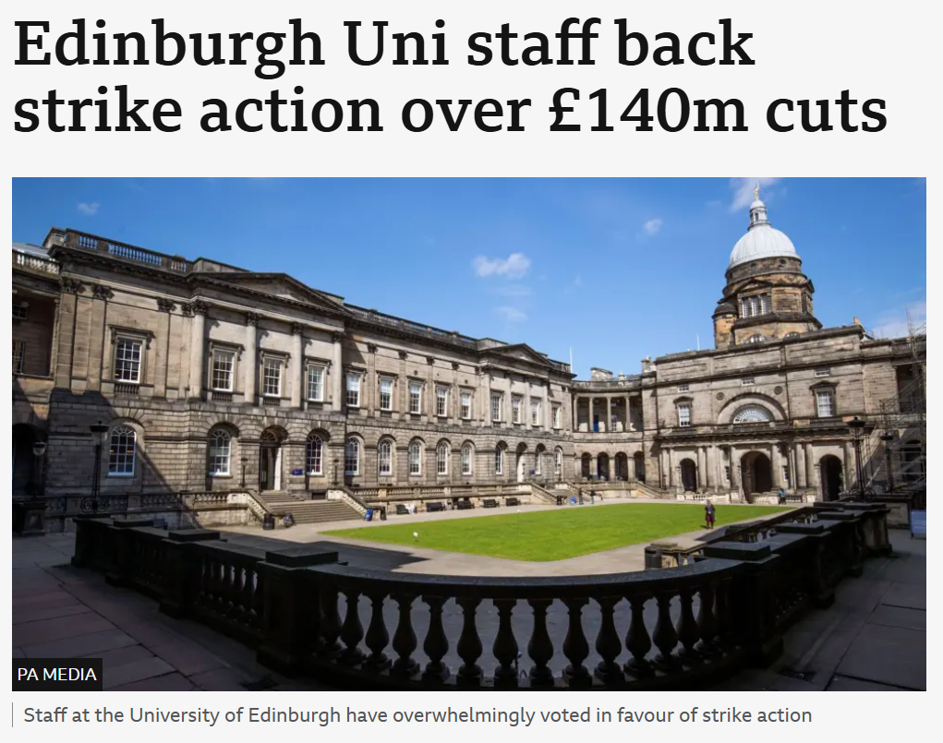
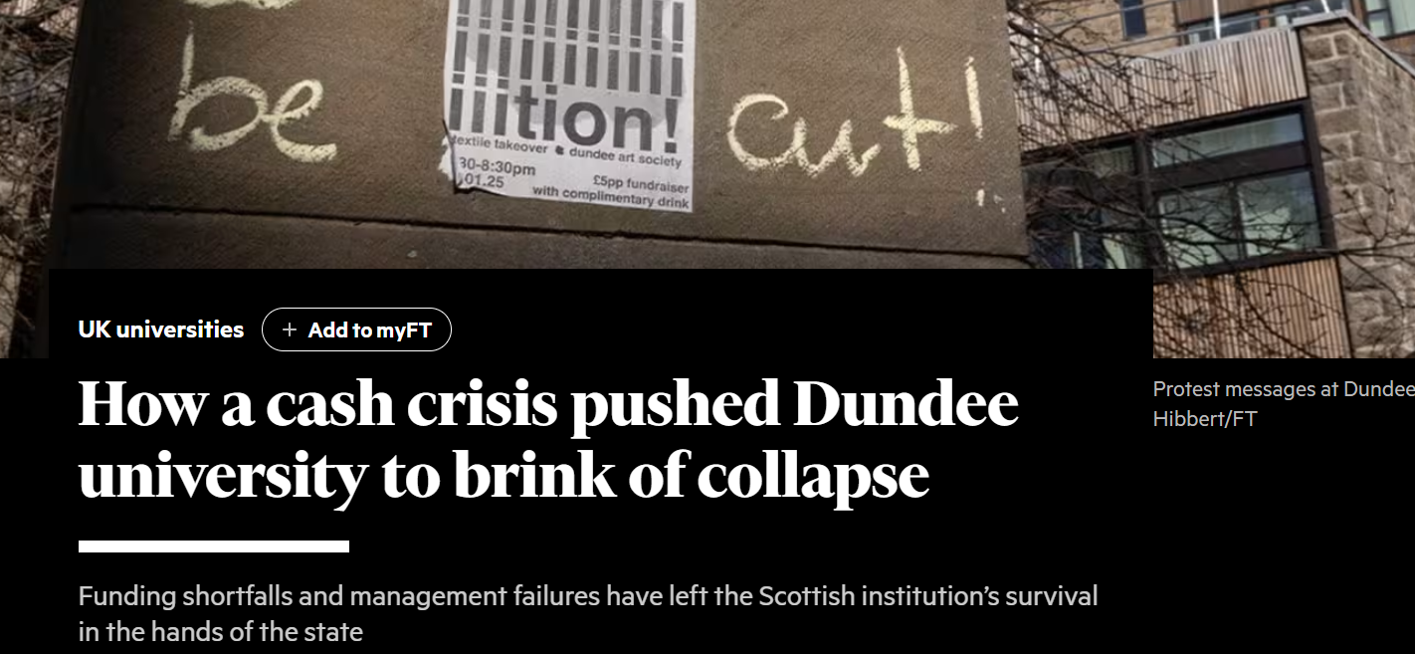
The result….
Notes:
Now more like 7 in 10 UK universities facing financial challenges

Slide 12
Diversity of the student body
The decline of the “traditional student”
Diversity brings great opportunity but also significant challenges
Over 25% international
About 25% disclosed a disability
Nearly 17% from socially deprived backgrounds (often “first in family”)
Fewer students living in university accommodation, more commuters
More online learners
More short course learners/work-based learning
Notes:
Still a high number of international students, particularly from countries in Africa and South Asia – cultural, academic and financial implications
Steady increases in students disclosing disabilities – in some institutions, over a quarter of students completing the NSS last year identified as disabled
Within this, mental health disclosures increasing, but so are students who identify as neurodiverse (autism, ADHD)
Increase in students identifying as nonbinary or trans
More students from widening access backgrounds (highest ever at 16.9%) – care experienced, estranged, student carers
White working-class boys struggling for degree attainment
Research – Pearsons, Thriving Learners – WonkHE/Pearsons research updated in 2023 confirms loneliness and disconnection persist and link this strongly to financial causes and to mental ill health as an effect. Particularly acute amongst certain groups – research students, LGBTQ+

Slide 13
Cost of Living Crisis
High proportion of students having to work part time – 69% of full time undergraduates (HEPI/Advance HE, 2025)
Approx 70% of Scottish HE students say they worry about money frequently or all the time (NUS, Cost of Survival)
Various research findings show high link between financial concerns and stress/poor mental health
  77% reported negative impact on mental health (BlackBullion Student Money and Wellbeing Report 2025)
  78% said money worries were causing “significant stress” (Experian/NASMA, 2024)

Slide 14
Loneliness and mental health
74% of students in Scottish universities experience low wellbeing (Thriving Learners, 2021)
16-24 year olds more likely to report feeling lonely “most or all of the time than older groups (Scottish Health Survey)
Nearly one-in-four students feel lonely ‘all’ or ‘most’ of the time (HEPI / Advance HE Student Academic Experience Survey, 2022)
Women, people from more deprived backgrounds, post graduate students and LGBTQ+ students all indicate higher levels of mental distress
Over the last decade some universities have seen over a 300% rise in students accessing mental health support

Slide 15

AI - friend or foe?
Opportunities | Risks | Questions for designing an optimum student experience
Quicker access to wider range of sources to support student learning | Increase in academic misconduct | How can we develop digital literacy to help students use AI safely and ethically to improve their academic learning, research and overall wellbeing?
Increased resources to support study skills, wellbeing, career development | Knock-on risks to visa and immigration compliance | If we continue to move down the road of online/inclusive learning, how do we balance this with reducing isolation and creating community and belonging?
Greater use of chat assistants to triage and respond quickly, reducing waiting times for student enquiries and support | Currently perceived as a risk and barrier to online learning = retrograde step in terms of inclusive design and assessment as recommended in Disabled Students’ Commitment
Significant time savings in research based and routine tasks
Reduction in reasonable adjustments if we embrace more online assessment

Slide 16
Student satisfaction scores are good
Overall satisfaction across Scotland: 80.7%
St Andrews and Open University = 90%
Staff explaining things well: 92%
Courses intellectually stimulating: 87%
Skills development:
85% said their degree helps build skills
83% said it prepares them for future careers

Slide 17
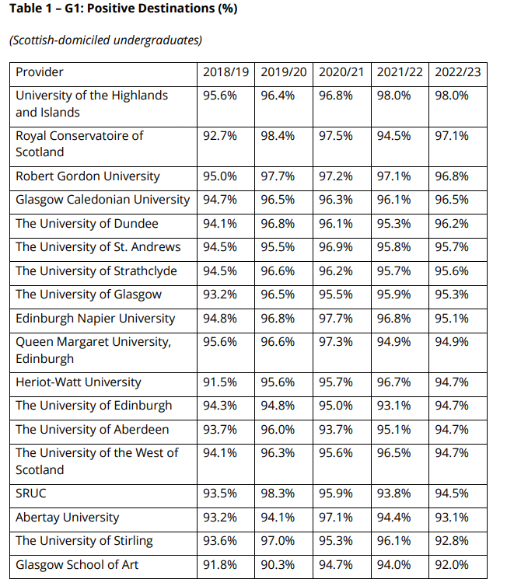
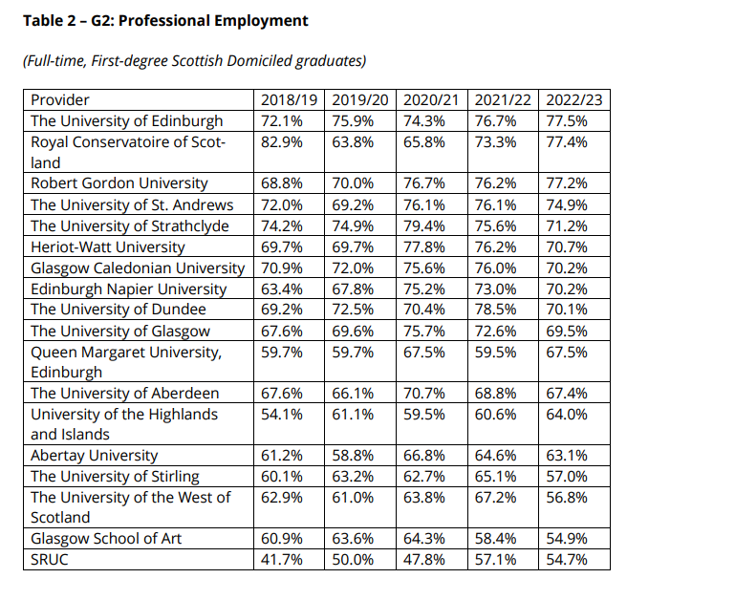
Graduate outcomes – Scottish universities (2025)
Notes:
88% of graduates from Scottish universities are in some form of work or further study (“positive destinations”)

Slide 18
Creating an exceptional student experience “beyond the classroom”
Proactivity
Prevention
Partnership
Prioritisation

Slide 19
Proactivity
Creating a sense of community and belonging: the impact cannot be under-estimated
Strong welcome and transitions support
  Pre-entry visits for targeted groups; pre-entry modules
  Encouraging disclosures
  Cultural integration activity
  Big focus on getting involved & extra-curricular
  Staff training
Embedding holistic skills development into the curriculum and encouraging ownership of the skills journey from the outset
“Every contact leaves a trace”
“It is important to ensure that the university is student ready – not just that the student is university ready

Slide 20




Proactivity: case studies
Notes:
Be Connected | About | University of Stirling
We are Strathclyde September Entrants | University of Strathclyde
Cultural-Services-Toolkit-Living-Black-at-University-Commission-2023.pdf
RGUplus | RGU

Slide 21

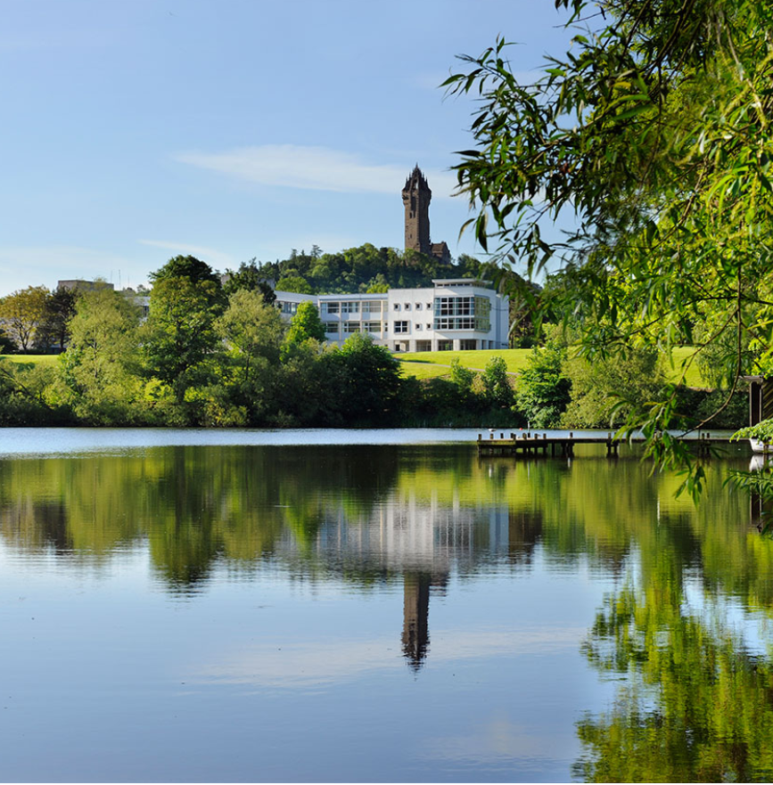
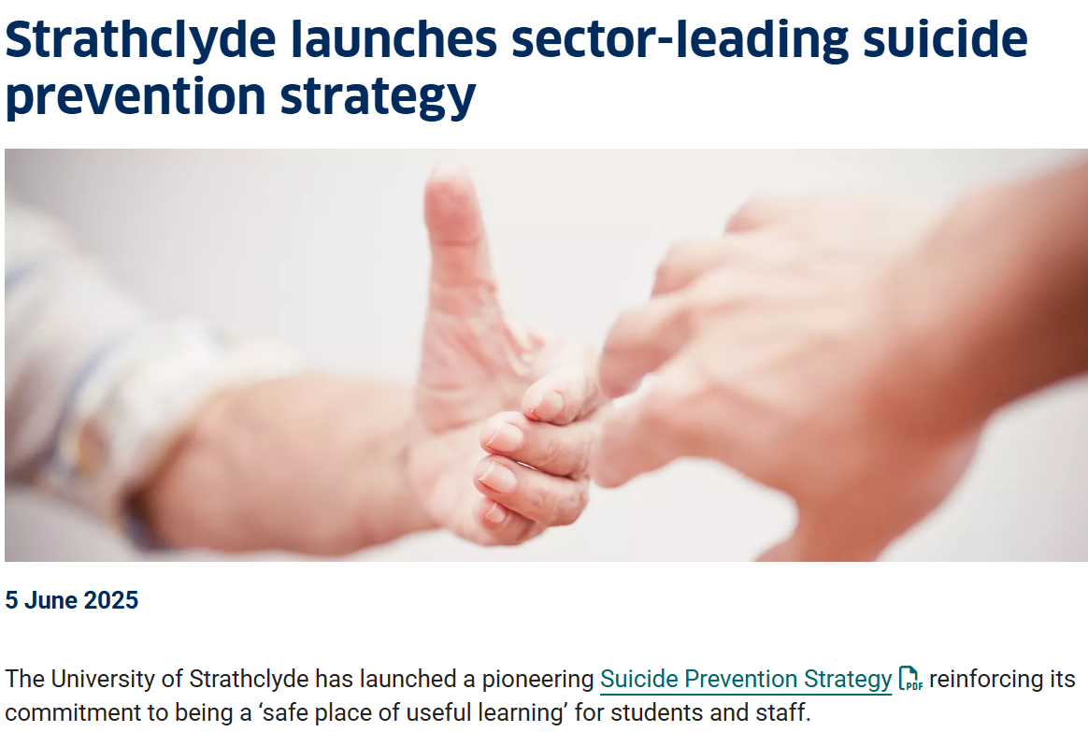
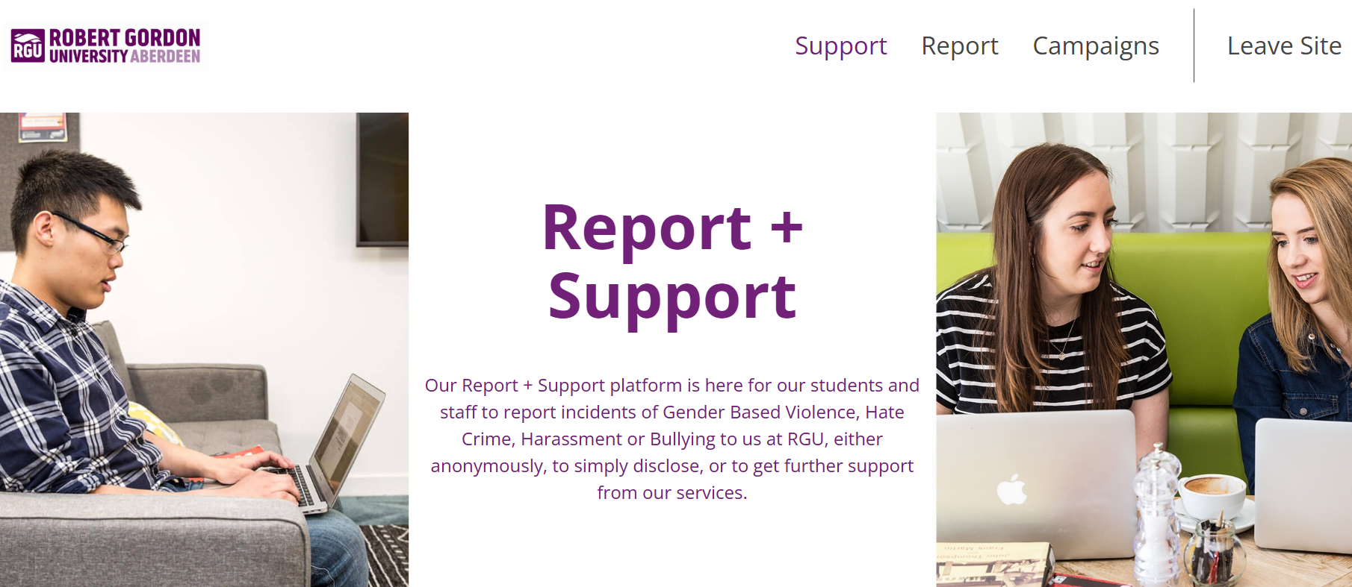

Prevention: Identifying and tackling issues before they escalate
Notes:
Strathclyde Suicide Prevention Strategy
Gender based violence
Stirling strategy
GCU Erase the Grey
Report and Support
Attendance and engagement monitoring

Slide 22

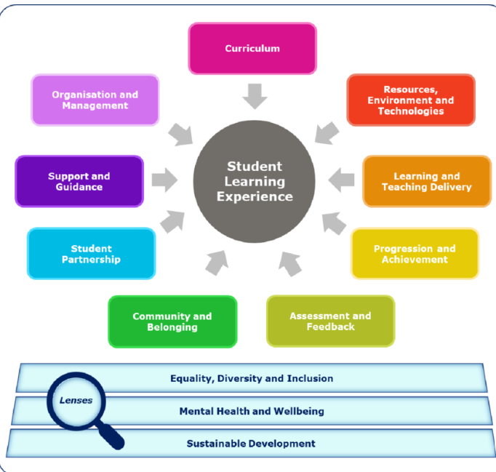
Partnership
The importance of co-design, genuine collaboration, and shared ownership of the student experience
SPARQS framework
  SLE_model_digital_resource.pdf
  Partnership_Ambition_resource.pdf
Notes:
What does it mean?
Co-designing experiences, integration into decision making structures, recognising experiences and needs of diverse student body
Real life example of change for the better e.g. new tuition fee structures

Slide 23

RGU Student Partnership Agreement 2024/25
Jointly developed with students
Key objective: “fostering an engaged and inclusive RGU community”.
Three key strands of activity:
  Teaching, Learning, and Assessment
  Extracurricular Activities Beyond the Classroom
  Identifying and Removing Barriers to Engagement
Notes:
Student Representation & Partnership | RGU

Slide 24
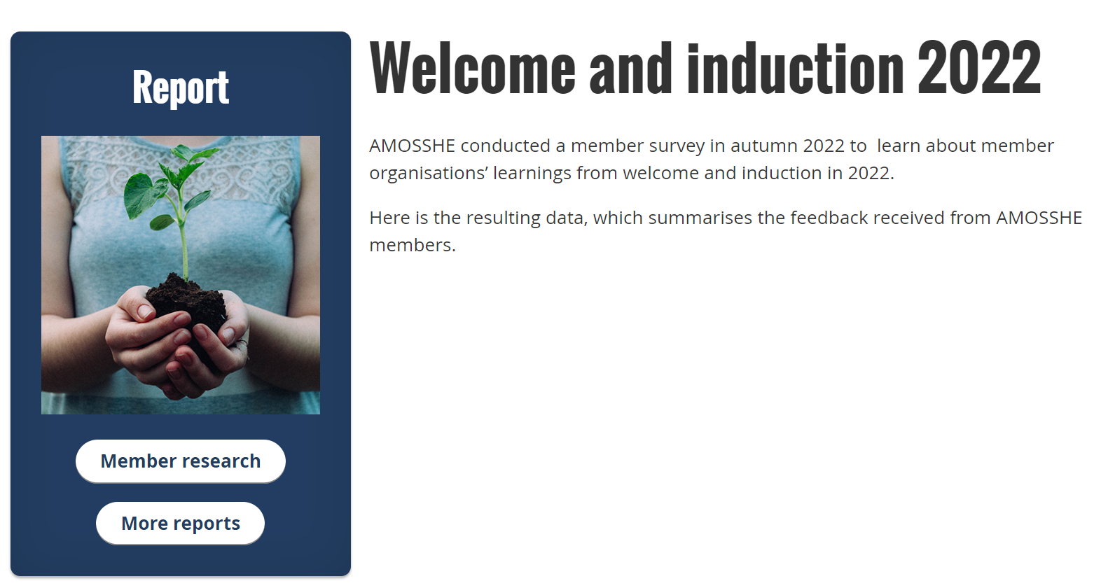
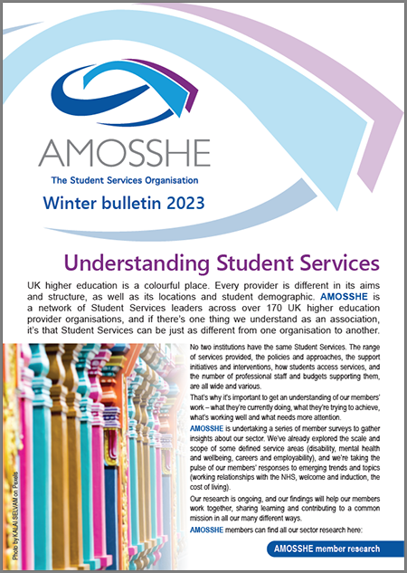


AMOSSHE is a UK wide membership organization which promotes the development and sharing of good practices within Student Services in the UK higher education sector at the national level.
We represent our members' interests by working closely with influential sector groups and policymakers.
Our 800 members contribute their time and expertise to benefit the whole community, and ultimately, the experiences of students.

Slide 25

Sector wide partnership work
Represented via AMOSSHE Scotland on several Scottish Government fora/working groups: collective voice and
  Equally Safe in Universities and Colleges
  Anti spiking in universities
  Scottish Government Student Mental Health Action Plan
  Suicide Prevention Network
Regional initiatives, shared innovations
  Fearless Edinburgh and Fearless Glasgow
  Joint sector training for staff on neurodiversity and gender-based violence (shared costs)
Working together to engage with NHS (Edinburgh, Tayside, Glasgow)
  Better referral pathways and information sharing….challenging work!
Notes:
I will explore some of this work in more detail during the workshop later today

Slide 26
Prioritisation
Managing growing and unrealistic expectations
A need to do more with less – funding cuts
A plethora of charters
What really matters and will make an impact?
  The importance of data
  Investing in evidence based initiatives; scrapping others
  Student involvement from the outset
  Shared services and initiatives
  Evaluating impact – not just uptake & satisfaction

Slide 27

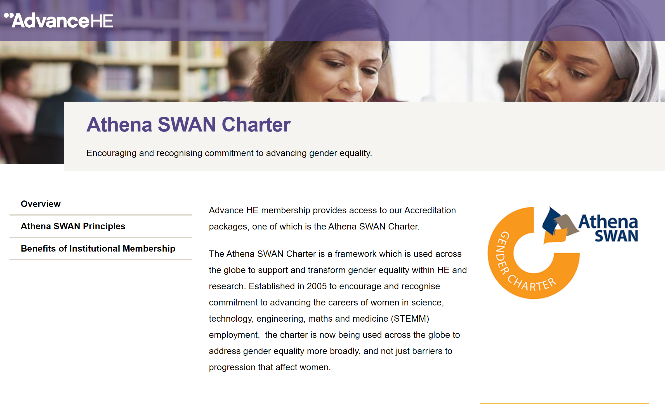

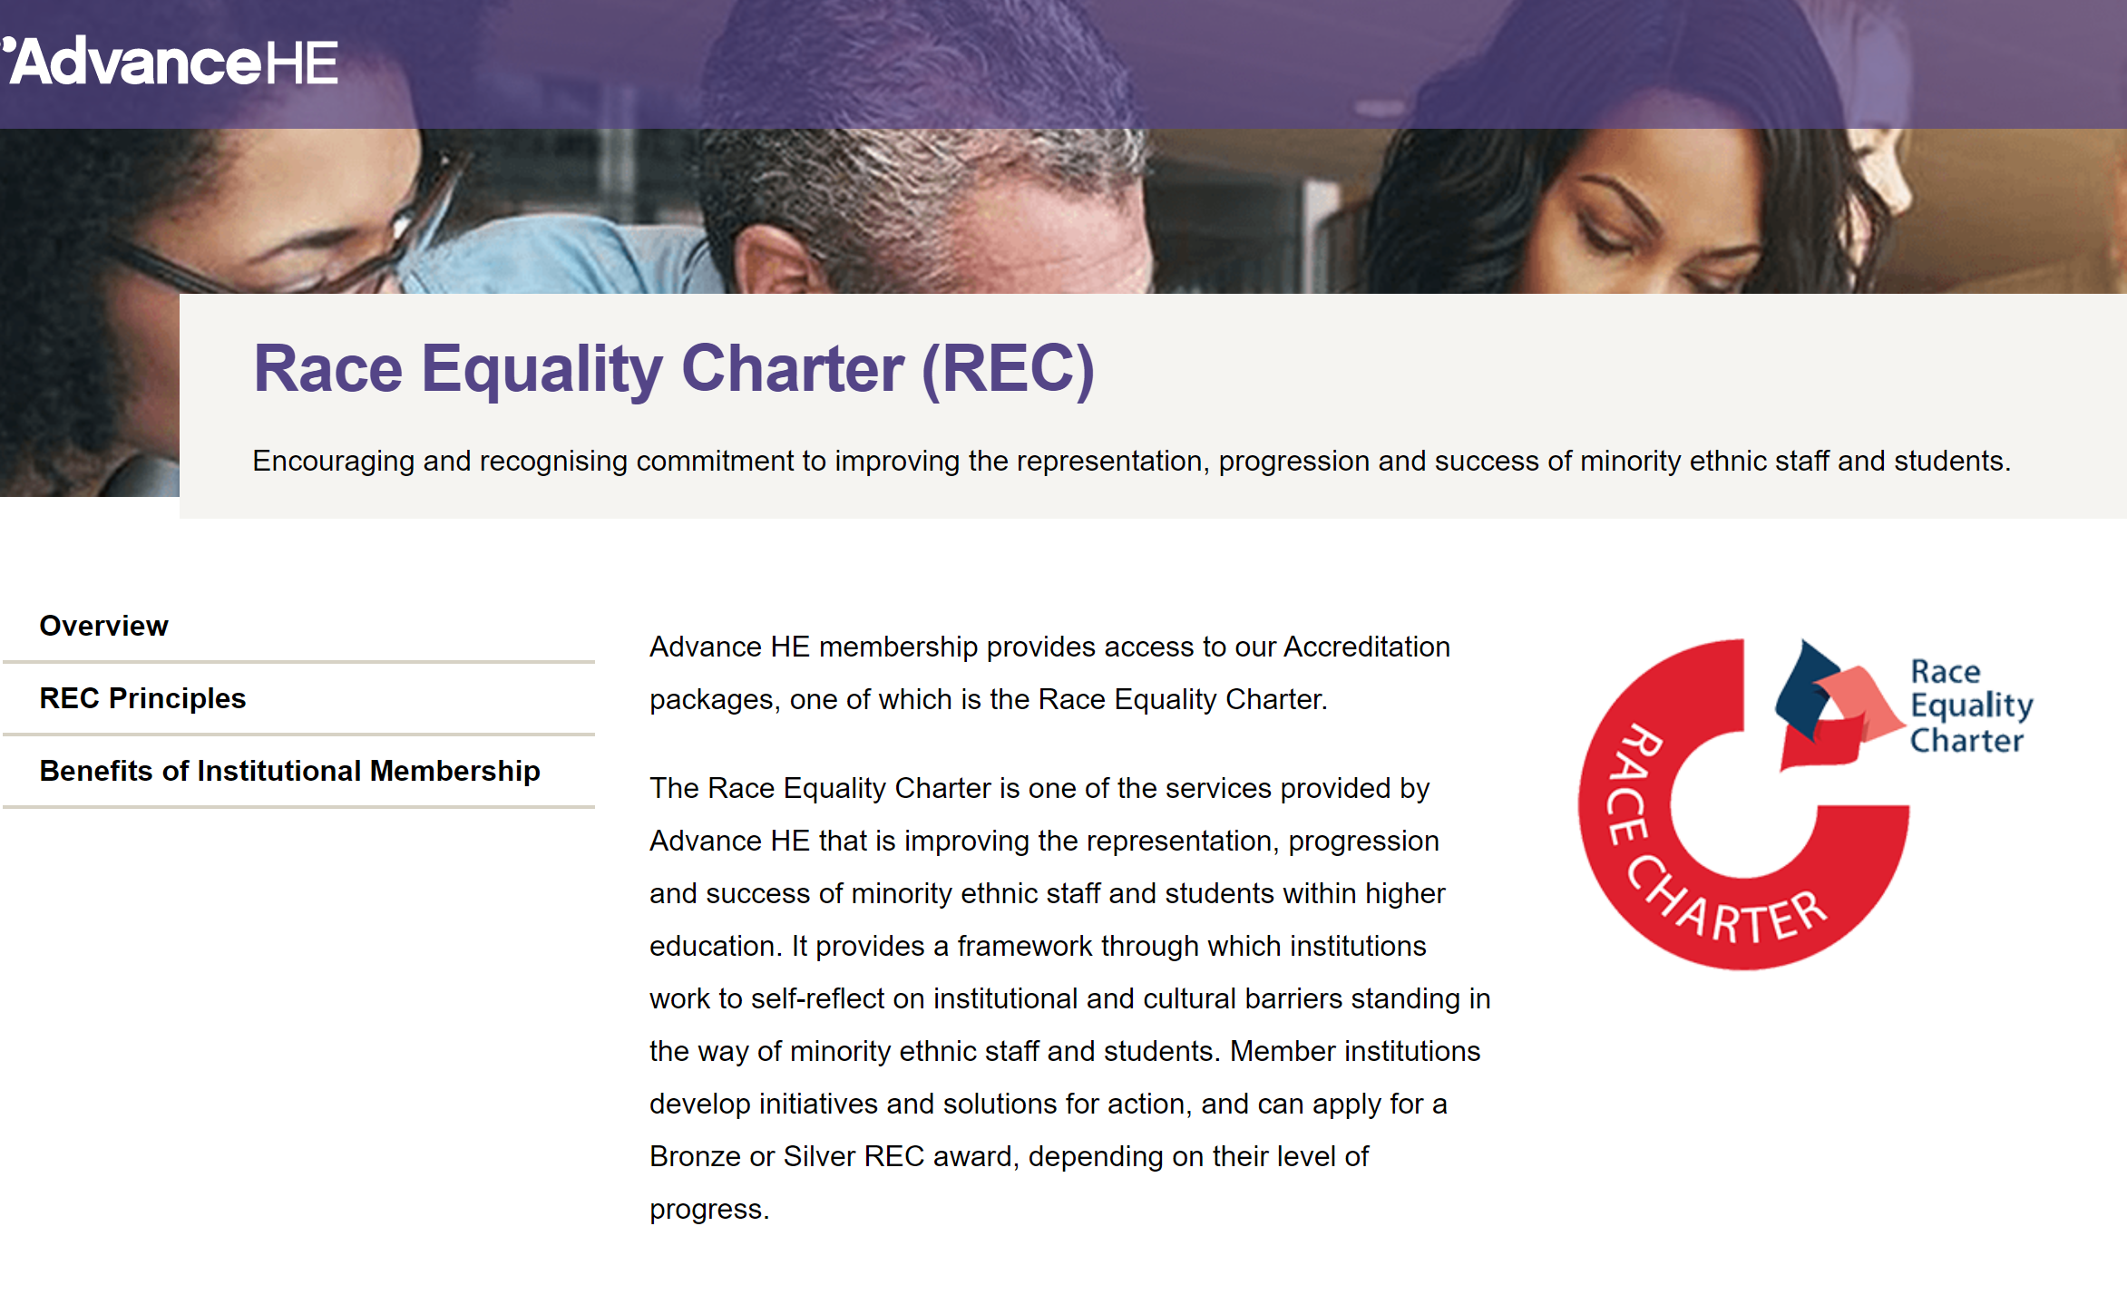
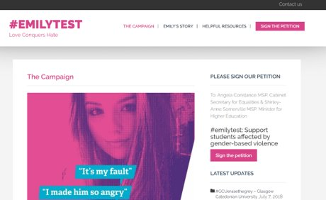


An abundance of charters with no new investment
Notes:
A flagship development was Halfon’s requirement for all English universities to sign up to the Mental Health Charter by September 2024. This comes at a fairly significant financial cost (fees and need for staff time to manage the process.)
The requirement comes with no additional investment in universities, and fails to recognise the associated costs of engaging.
7.6m
On the other side of the argument, campaigners with lived experience of student suicide argue that the requirement is toothless, as it doesn’t actually require universities to complete the Charter process, meaning that they don’t have their approaches to student mental health assessed independently.
AMOSSHE recognises the key role that universities have in supporting students who are at risk of who are experiencing a decline in their mental health, but there are a few principles we want politicians, campaigners and sector leaders to understand:

Slide 28
Aim: designing a support and development framework that is both fit for purpose and efficient given declining resources and funding pressures
Attempts to re-focus energies and cut through the bureaucracy
  In Scotland: 4 Scottish Mental Health Principles
  In Scotland: national equality outcomes (persistent inequalities)
  In England: HEMHIT
  Disabled Students Commitment – covers inclusivity more generally – is this where we need to focus?
A move to whole institution models of support
Notes:
Will discuss this in more detail during the mental health workshop later today

Slide 29
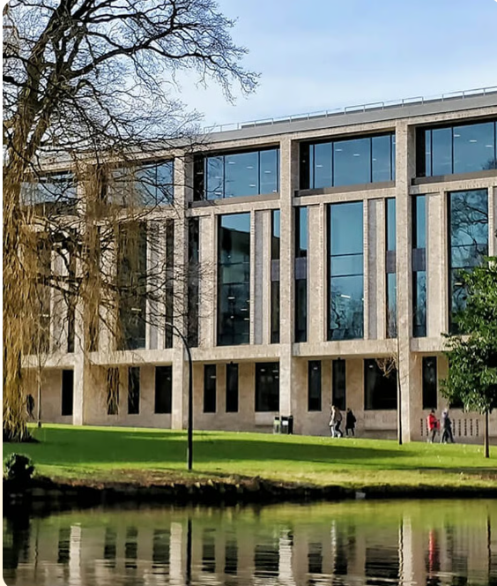

Whole institution models of support
Moving personal tutors to a whole School support model (“Team Around A Student”) | Introduction of student success coaches
From personal tutors to embedded student support teams & wellbeing officers in Schools | Award winning wellbeing facility for students, online resource Hub for staff, and new training programme
Notes:
Consideration of new models that are fit for purpose
Move away from traditional academic PT models to student experience strategies, support integrated into Schools, whole-School and whole institution support frameworks and referral pathways, boundaries, training, referrals

Slide 30

Listen, triage and refer model
“No wrong door”
Clear referral pathways (routine, urgent, out of hours)
Clarity on boundaries and limitations
Fundamental training e.g. First Responder, safeguarding, neurodiversity
Build into staff induction and link to progression and promotion
Supporting staff to support students: whole institution approach

Slide 31
Key points to consider
Champion a culture that embraces diversity, and which is founded on equity, inclusion and wellbeing. Without this, performance and potential will not be realised
Embrace a whole institution approach: leadership is vital. Who is recruited and promoted?
Support staff to support students: identify skills implications for staff (is your university student ready?)
Consider proactivity, prevention, partnership and prioritisation
Invest in systems, data, and technology to streamline processes; but remember that data without human response and support is useless
Be clear about boundaries and areas of responsibility: be publicly accountable for progress

Slide 32
Jill Stevenson
Director of Student Life
Robert Gordon University
j.stevenson6@rgu.ac.uk
RGU
AMOSSHE Homepage

