Slide 1
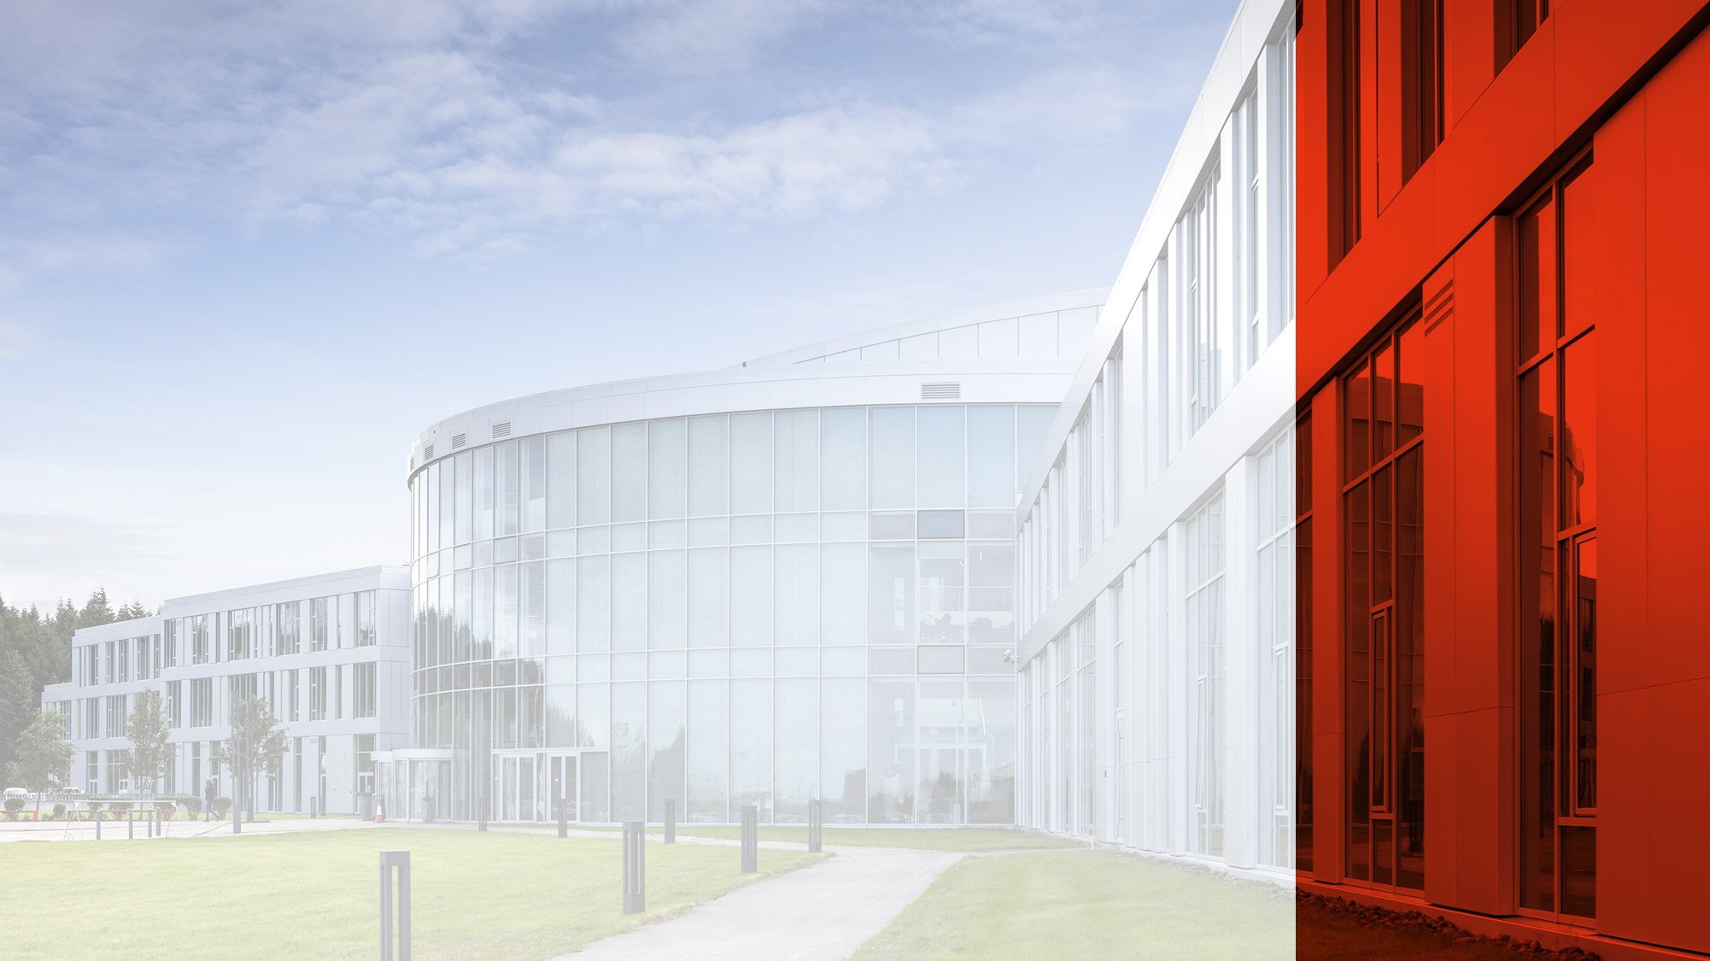
Fostering Resilience and Well-Being: Reykjavik University's Approach to Student Mental Health
Gréta Matthíasdóttir
Sviðsstjóri | NEMENDAÞJÓNUSTA
Head of Student Services

Slide 2
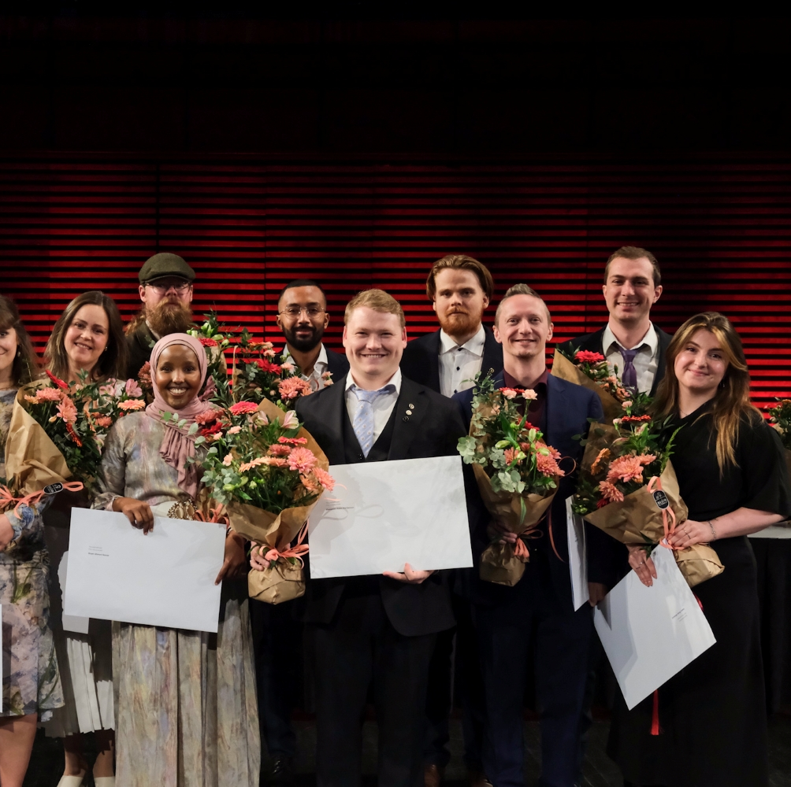
Fostering Resilience and Well-Being: Reykjavik University's Approach to Student Mental Health:
Means actively identifying and work with barriers that prevent students from succeeding. We tray to build environment where all students have access to the resources, and support they need to thrive—not just survive

Slide 3

Our goal is always to support students so that they succeed in their studies

Slide 4

To thrive—not just survive– “the bridge”

Slide 5

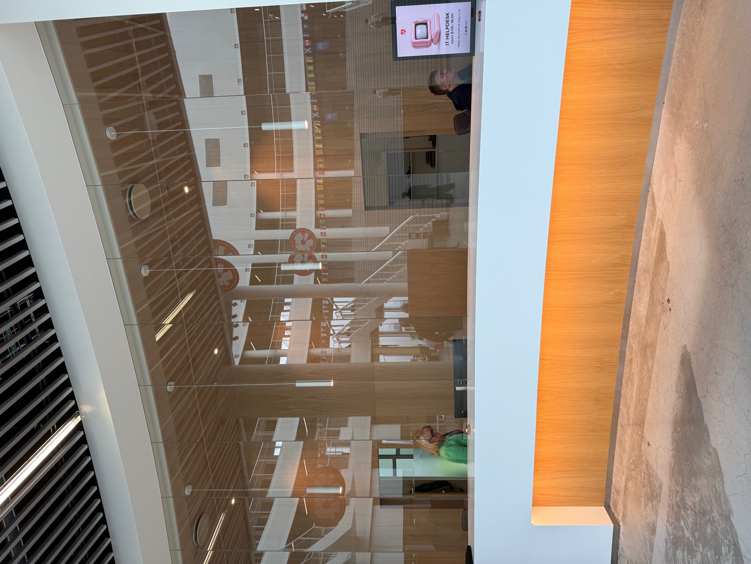

Service desk

Slide 6



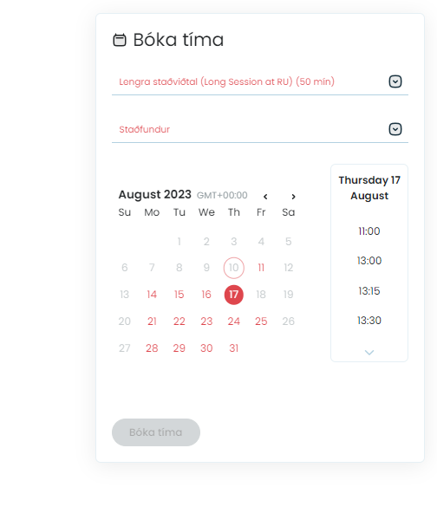
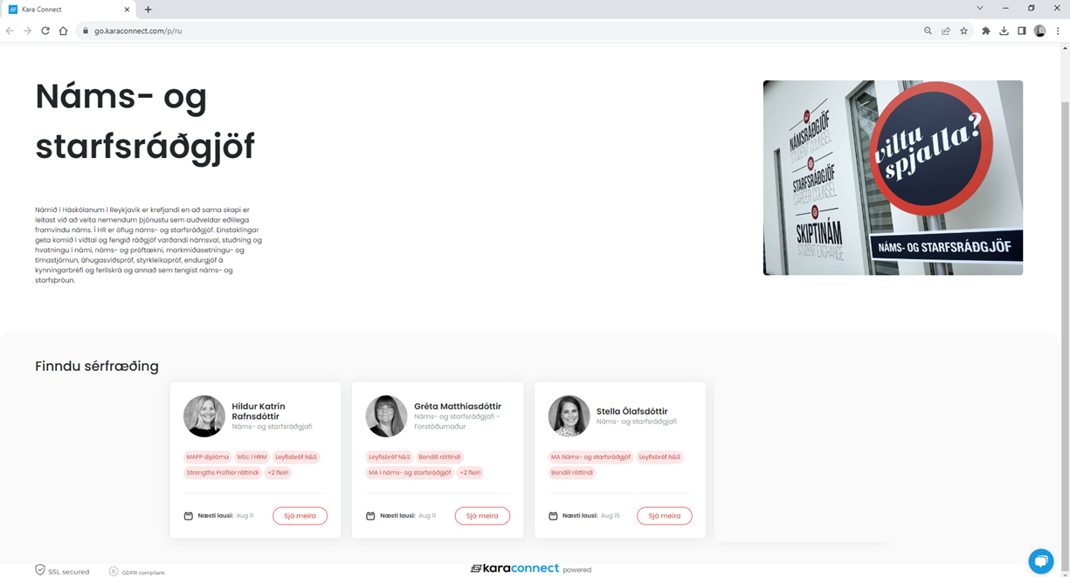
Student Counselling

Slide 7

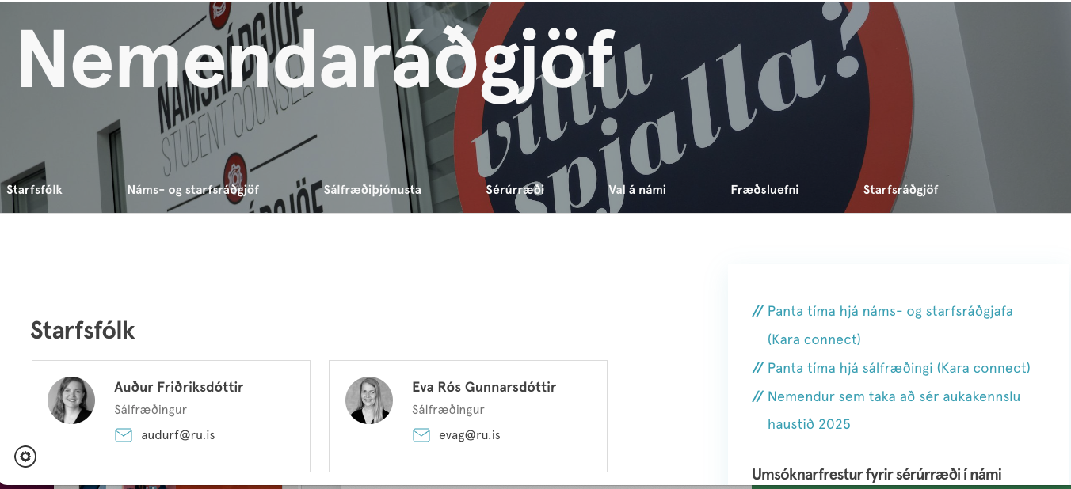
Psychological Services
Free of charge for all RU students
The team aims to promote and support students´ mental, psychological, and emotional health
Provide individual counseling and support regarding a broad range of problems
Help students find ways to deal with emotional issues
Give information regarding/or referral to more appropriate services if needed
Mostly CBT based

Slide 8
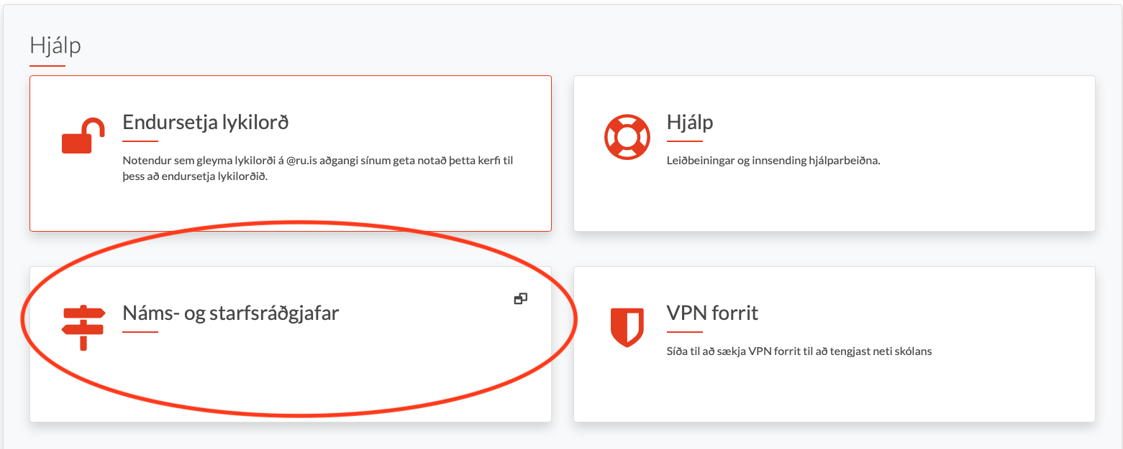
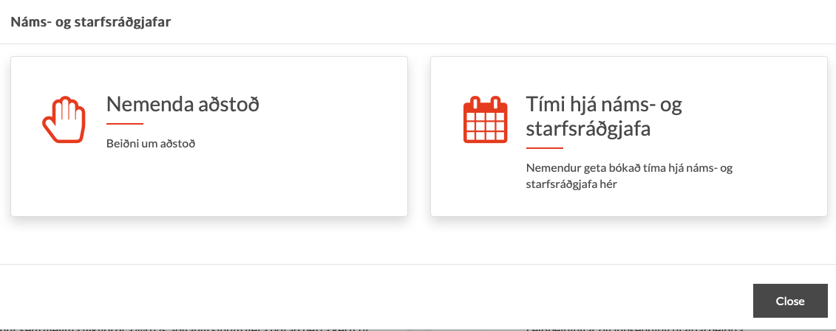
Student support
Counsellors provide counselling and assistance for students with specific disabilities that could impact their academic success.
All requests must be accompanied by a certificate or explanatory letter from a specialist in such conditions as:
Visual impairment, blindness, legal blindness
Hearing loss, deafness
Specific learning difficulties, e.g. dyslexia
Neuropsychological problems e.g. ADHD, Tourette’s, or autism spectrum
Physical Disability, e.g. disabilities or temporary mobility impairment due to an accident• Chronic illness, e.g. cancer, rheumatism, MS, MND or poor mental health.

Slide 9

Students who struggle with barriers that can be considered temporary and that can be worked with, cured or made more manageable apply for accommodations on a per-semester or per-academic year basis.
Those with a permanent disability should apply for accommodations at the beginning of their studies, and they will be registered for the duration of their time at RU.

Slide 10


Workshops and lectures (Psychologists and counsellors)
Workshops for students
Test/Exam and study anxiety workshop based on CBT
Every semester
CBT for Low Self-Esteem in the school environment
Every spring semester
Shorter lectures for students and/or staff members
Neurodiversity
Conflict Management
Procrastination
Positive psychology
Wellbeing

Slide 11
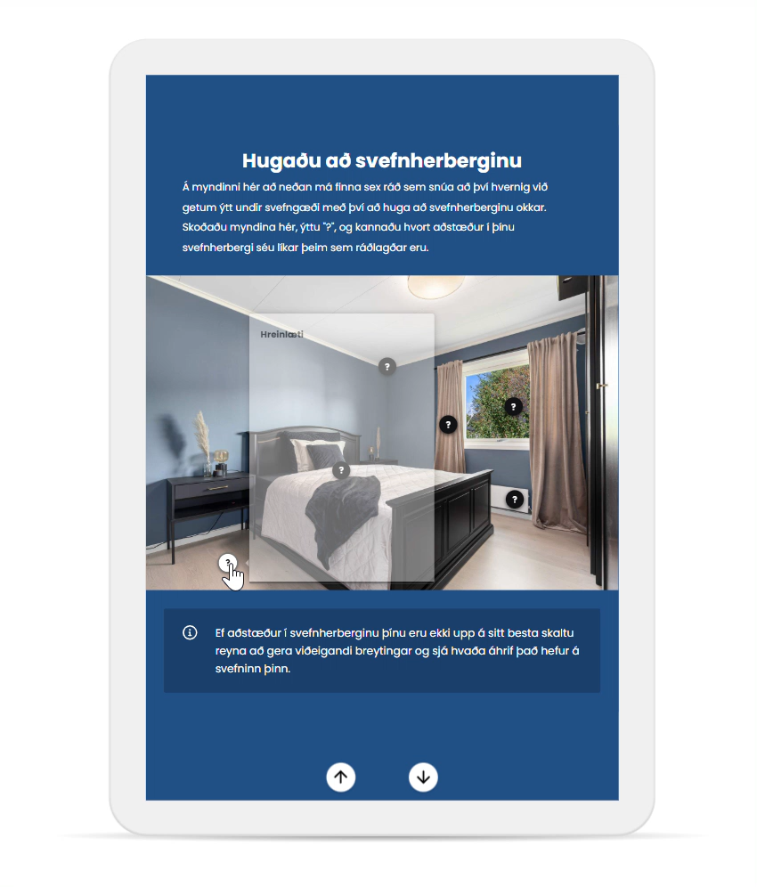



Psychoeducation
Interactive material in progress
better sleep, stress management, and attention & concentration
On the RU website we have a wide range of lectures and booklets for students which contains various material.
Perfectionism, procrastination, grief, depression and anxiety etc.
Notes:
Kannski segja frá nýja forminu af fræðsluefni? Interactive fræðsluefni.

Slide 13

Mentor program
This autumn, Reykjavík University launched a new support service aimed at easing the transition for first-year students and reducing dropout rates. As part of the initiative, all new students were assigned a dedicated mentor during their first eight weeks at the university.

Slide 14

Mental awareness week – Our biggest event
January 2017 for the first time
Started as collaboration between RU Career and Guidance Councelling and the Department of Psychology
Now collaboration beween RU Psychological Services and the Department of Psychology
In 2023 we moved it to October
Same week as the World Mental Health Day (October 10th)

Slide 15
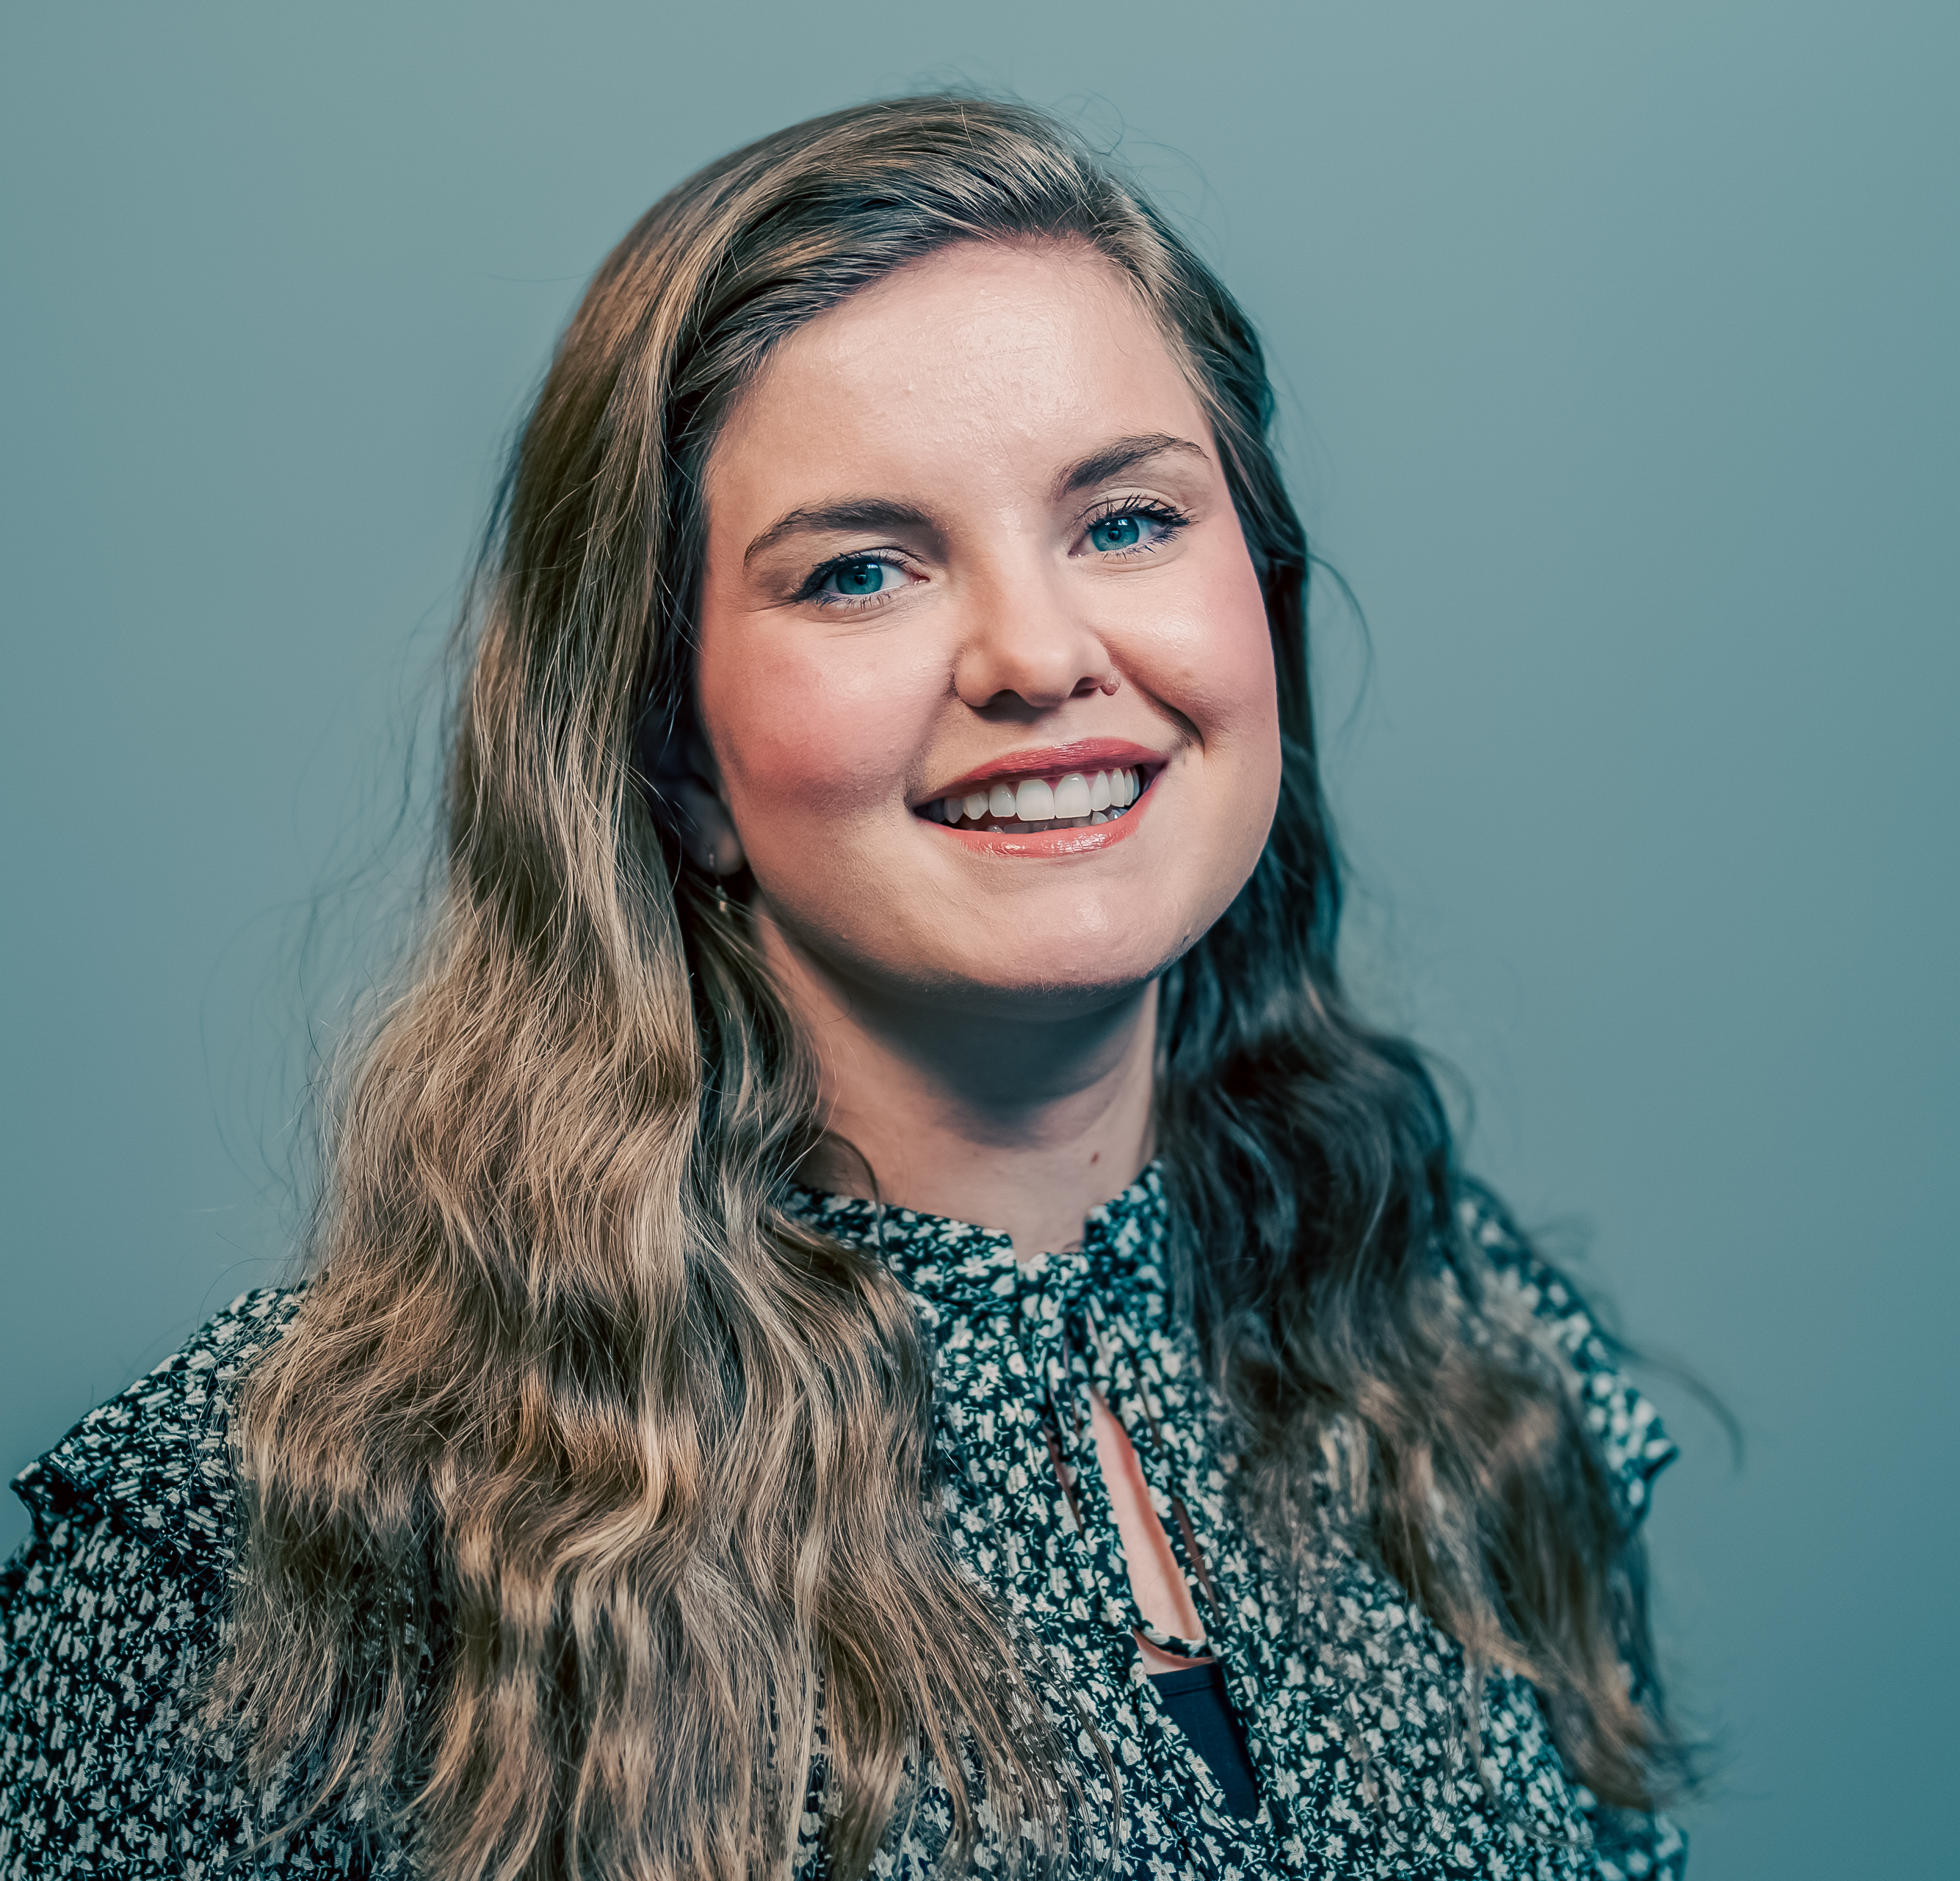
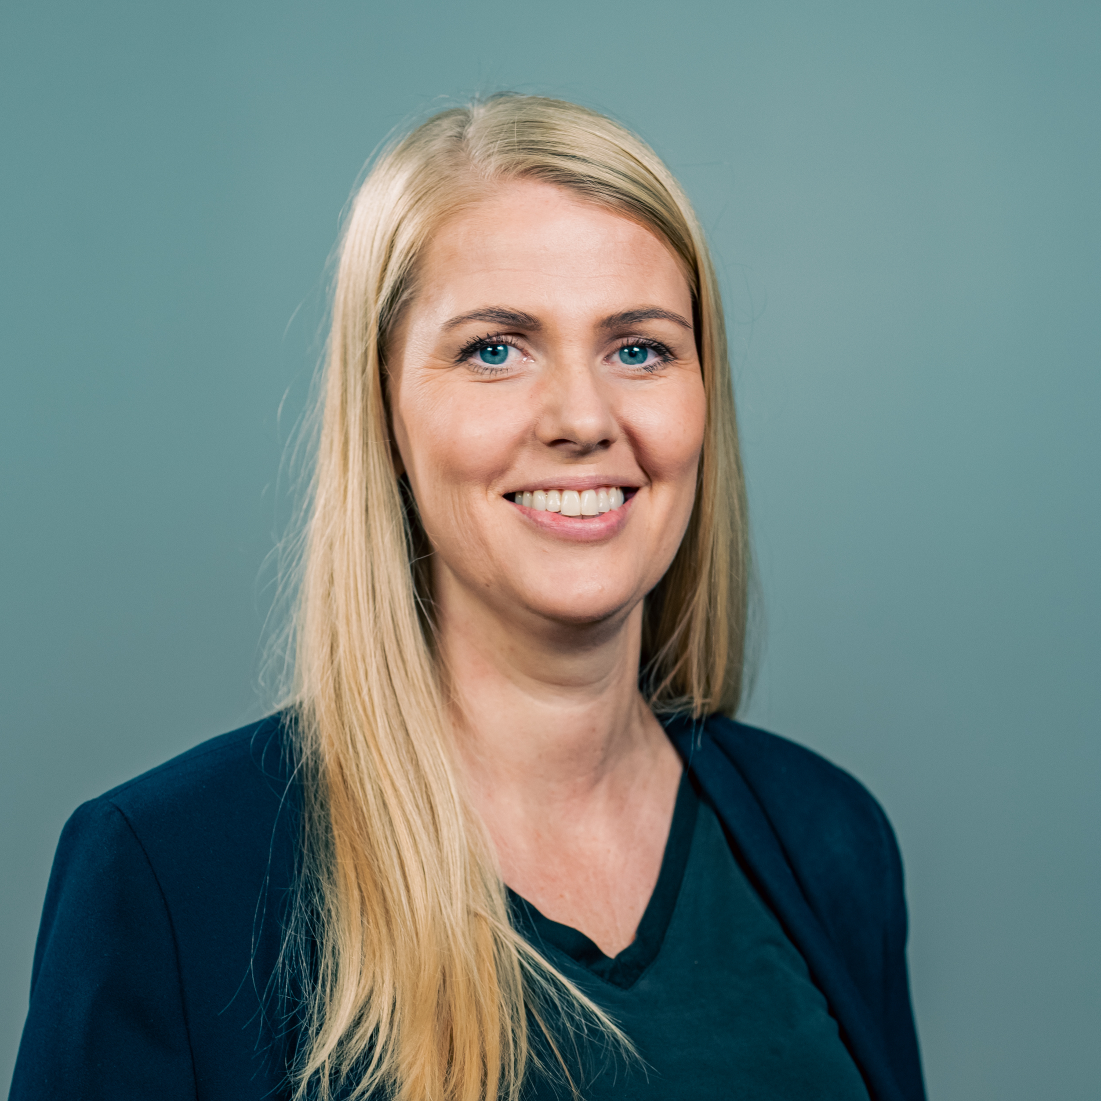

January 2018
August
2020
August
2022
August 2025
How we built the psychological service
Clinical training center for MSc students in clinical psychology
(Department of Psychology)
Auður Friðriksdóttir
Psychologist
Another full time clinical psychologist
Full time clinical psychologist
RU Students offered to attend 6 session CBT workshop for depression and anxiety
Individual sessions
Workshops
Training for MSc students in clinical psychology
Eva Rós Gunnarsdóttir
Psychologist
Provided by contract psychologist (one work day per week) – were able to offer some individual support
MSc students in clinical psychology

Slide 16
Psychological services - our clients
Autumn semester ´22 to spring semester ´25
134-176 students per semester
484-732 booked individual sessions per semester
Psychological services
(school year 2023-2024)
On-site sessions and online sessions
1-12 sessions per student (average 4 sessions)
More students attend workshops/courses/lectures

